Slide 1
DevOps and its tools

Slide 2
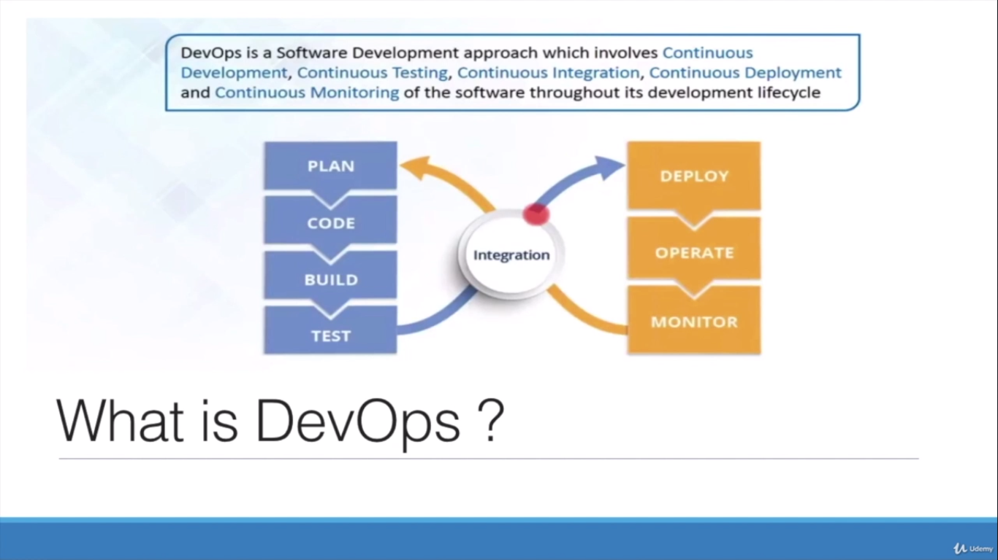
What is DevOps?

Slide 3
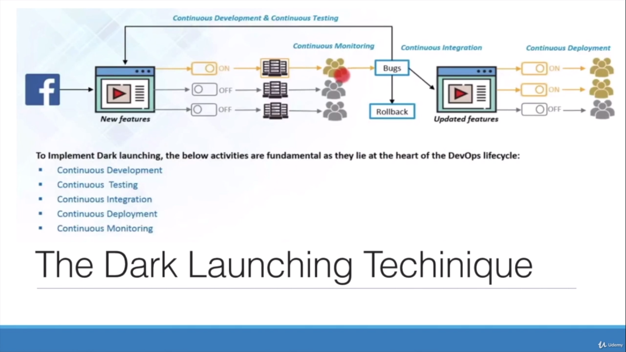
What is DevOps?

Slide 4
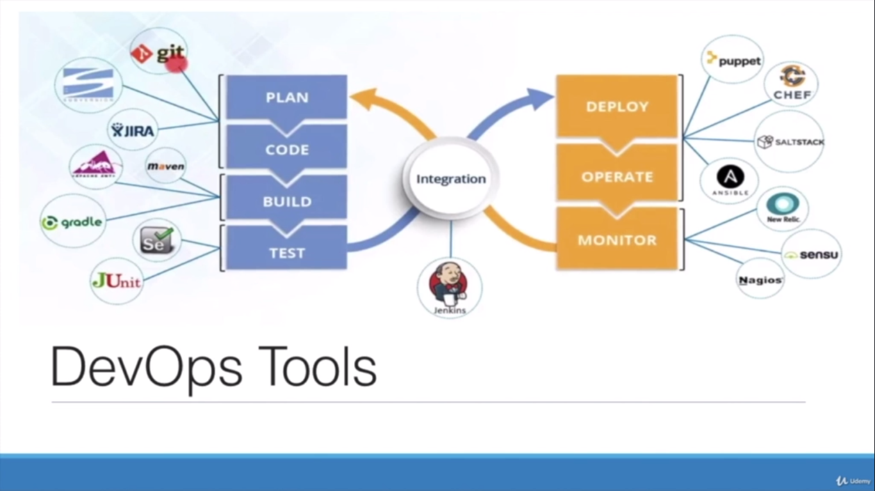
What is DevOps?

Slide 5
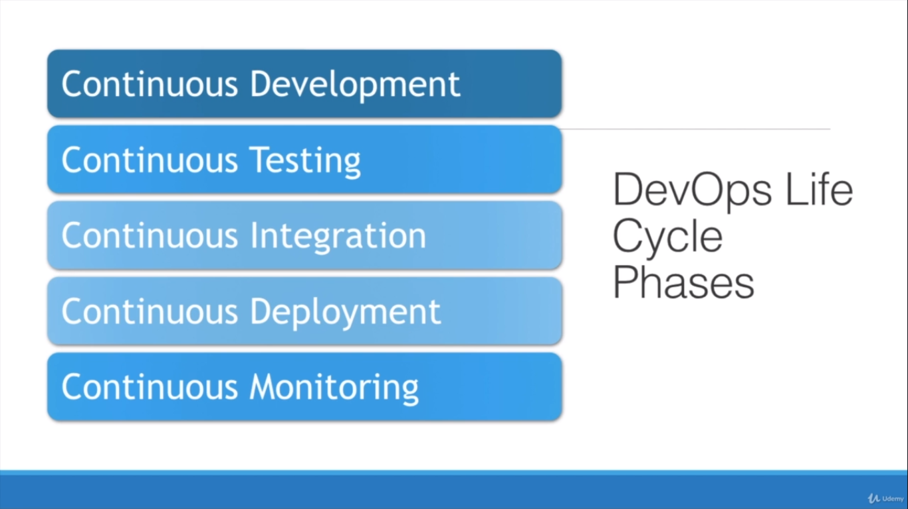
What is DevOps?

Slide 6
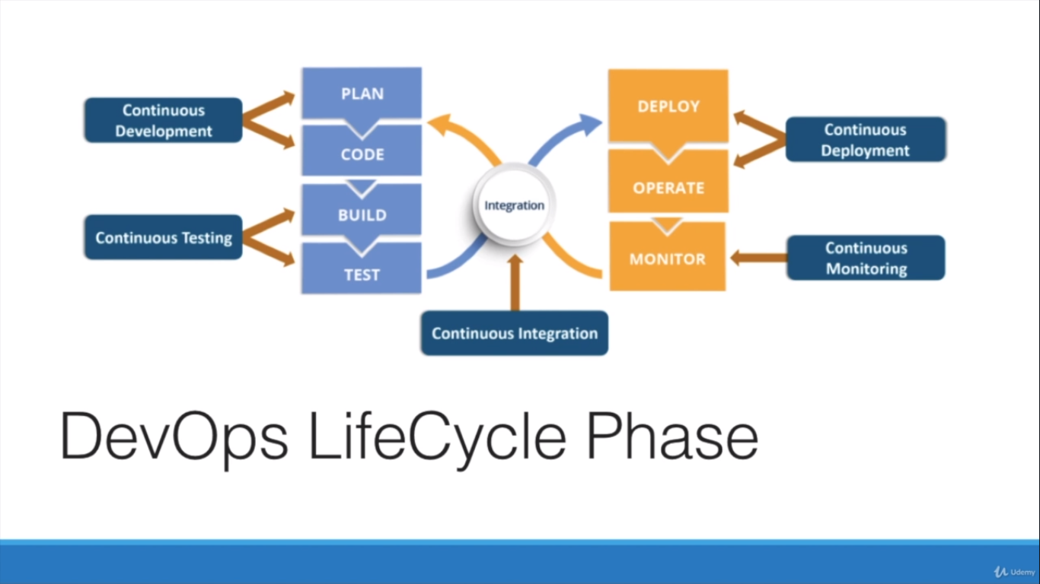
What is DevOps?

Slide 7
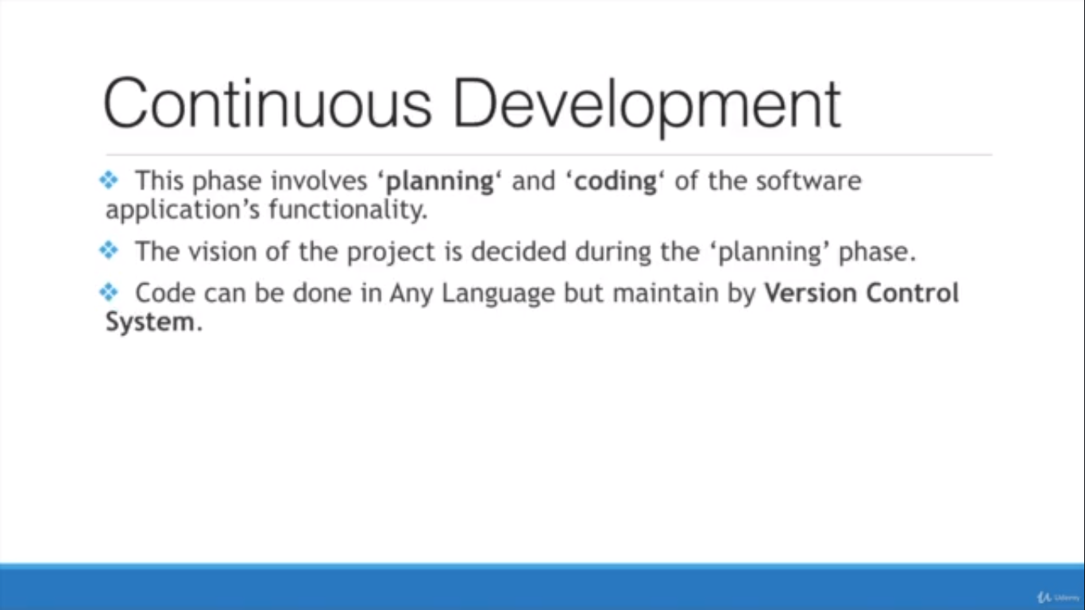
What is DevOps?

Slide 8
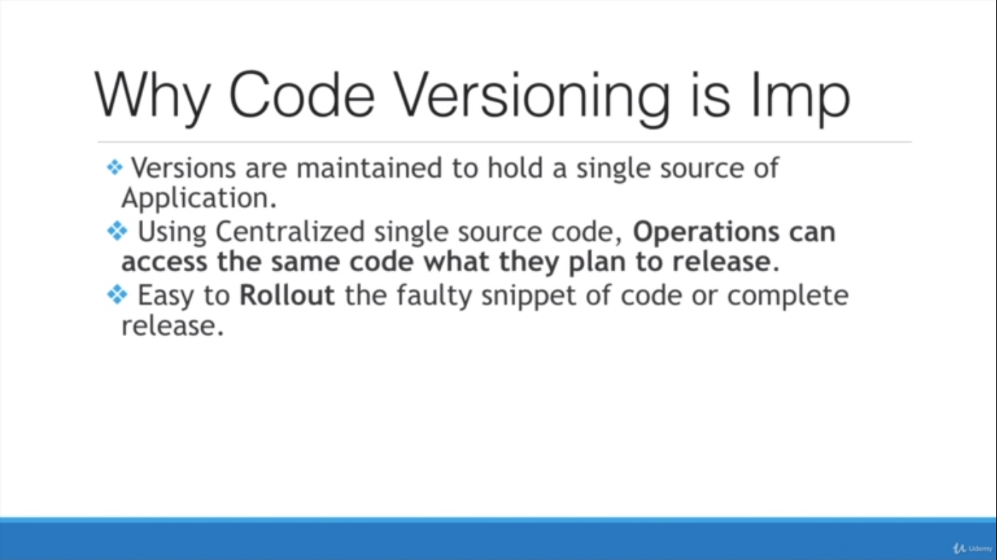
What is DevOps?

Slide 9
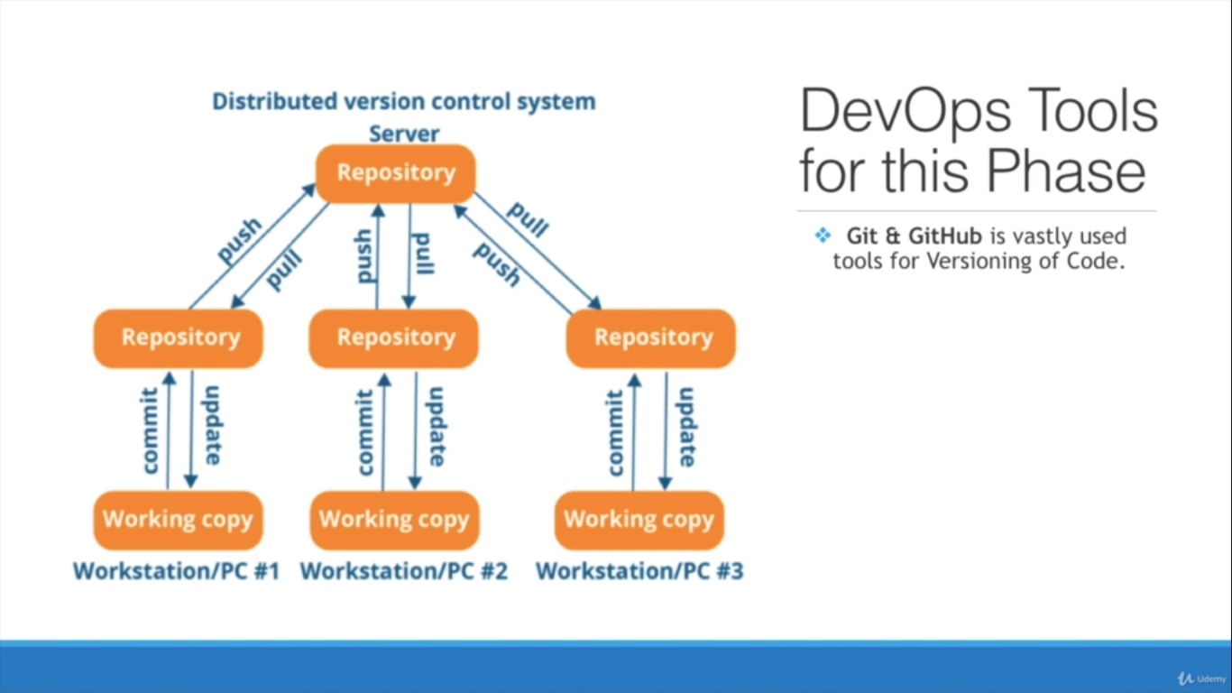
What is DevOps?

Slide 10
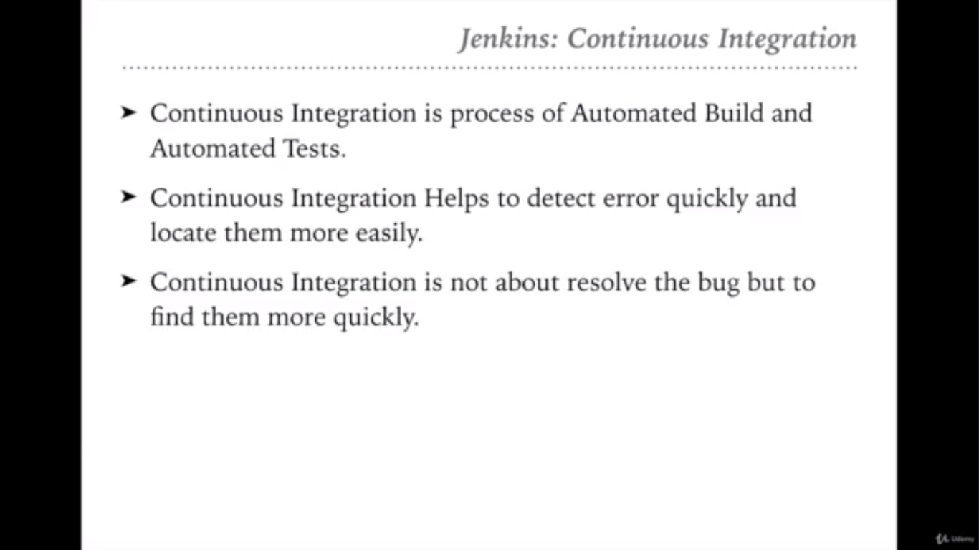
What is DevOps?

Slide 11
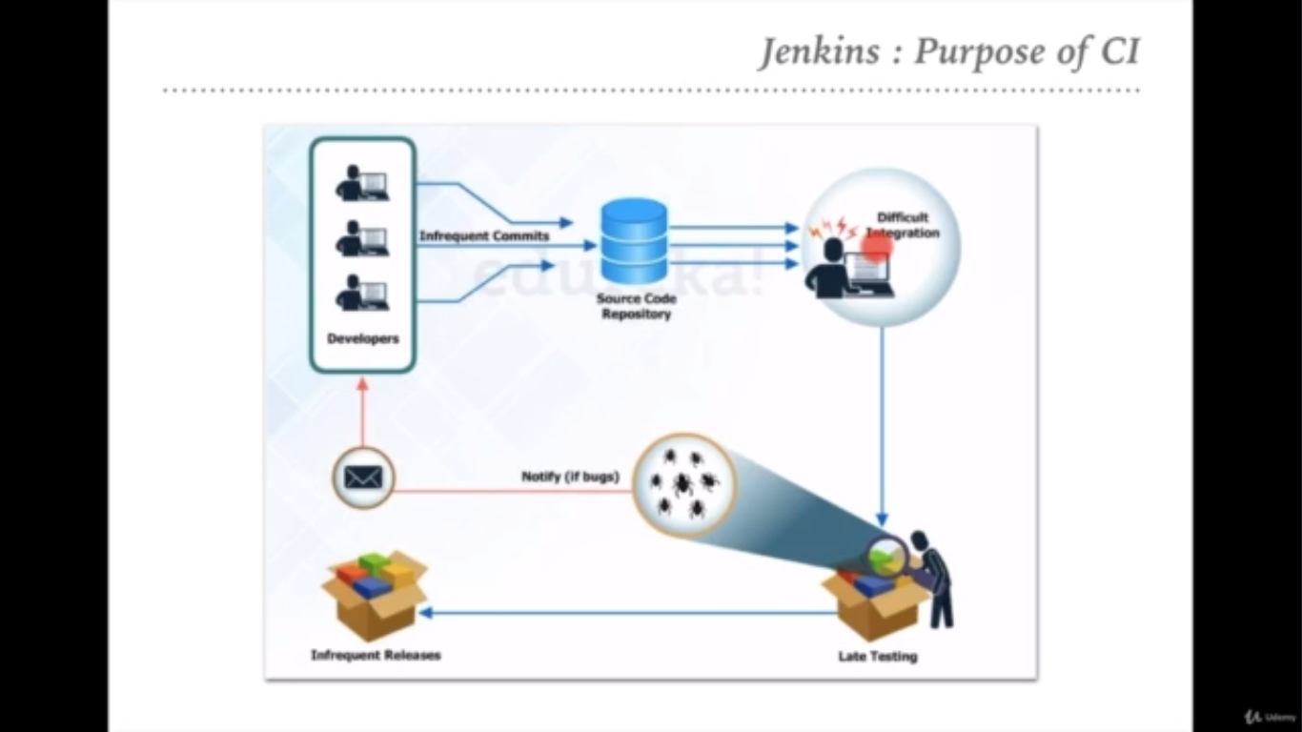
What is DevOps?

Slide 12
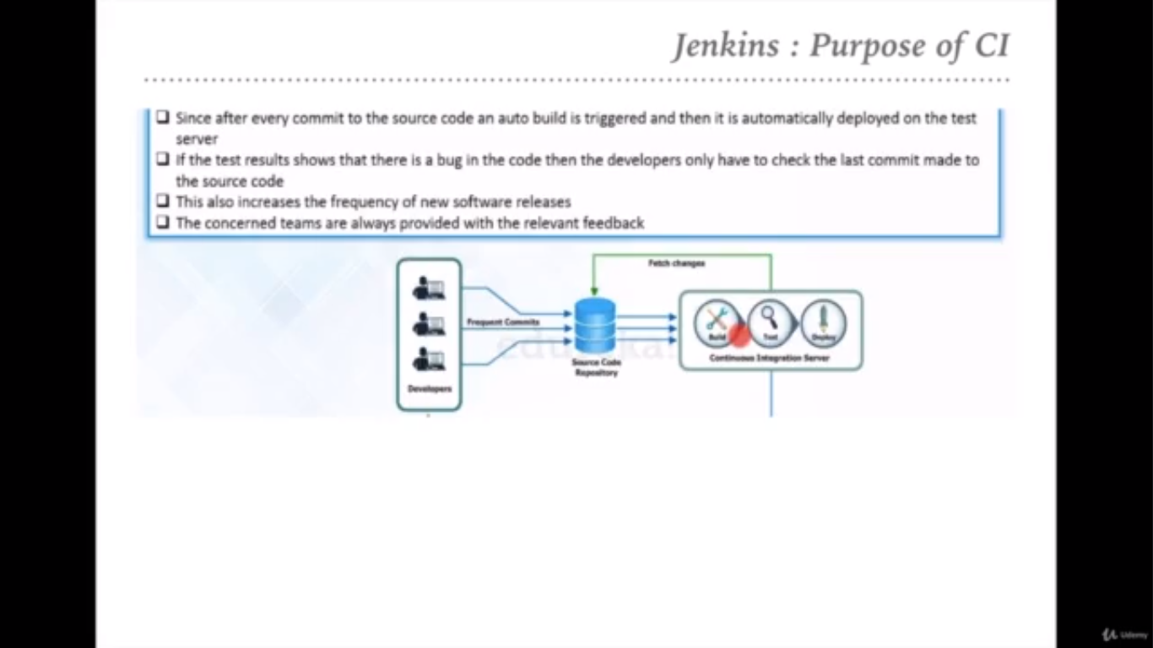
What is DevOps?

Slide 13
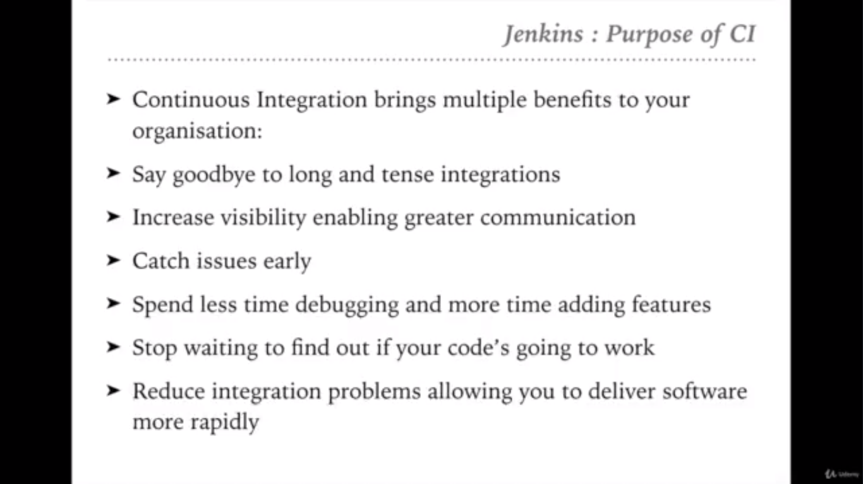
What is DevOps?

Slide 14
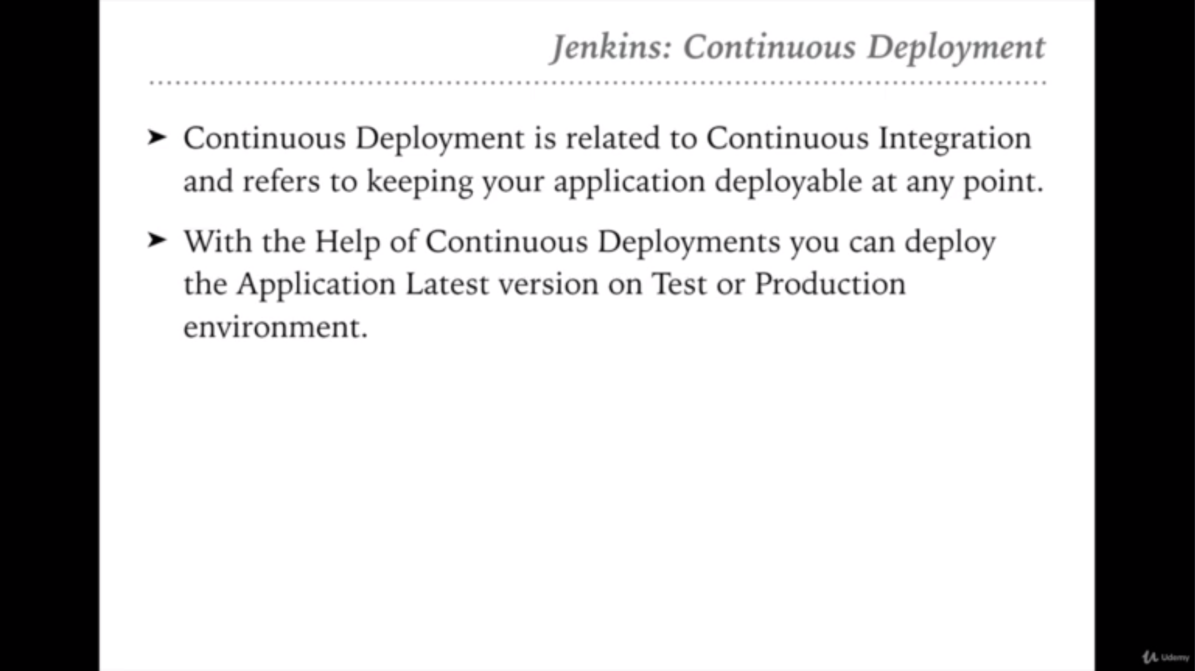
What is DevOps?

Slide 15
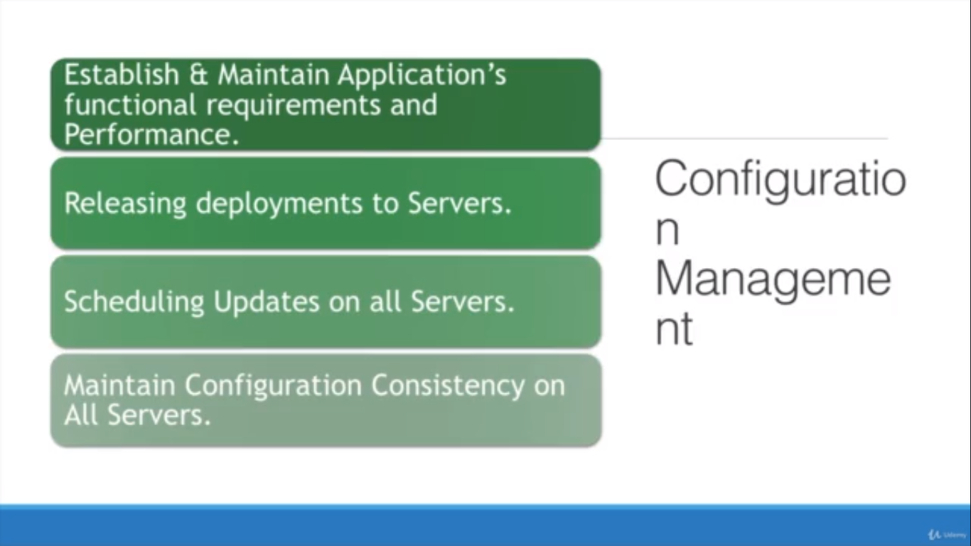
What is DevOps?

Slide 16
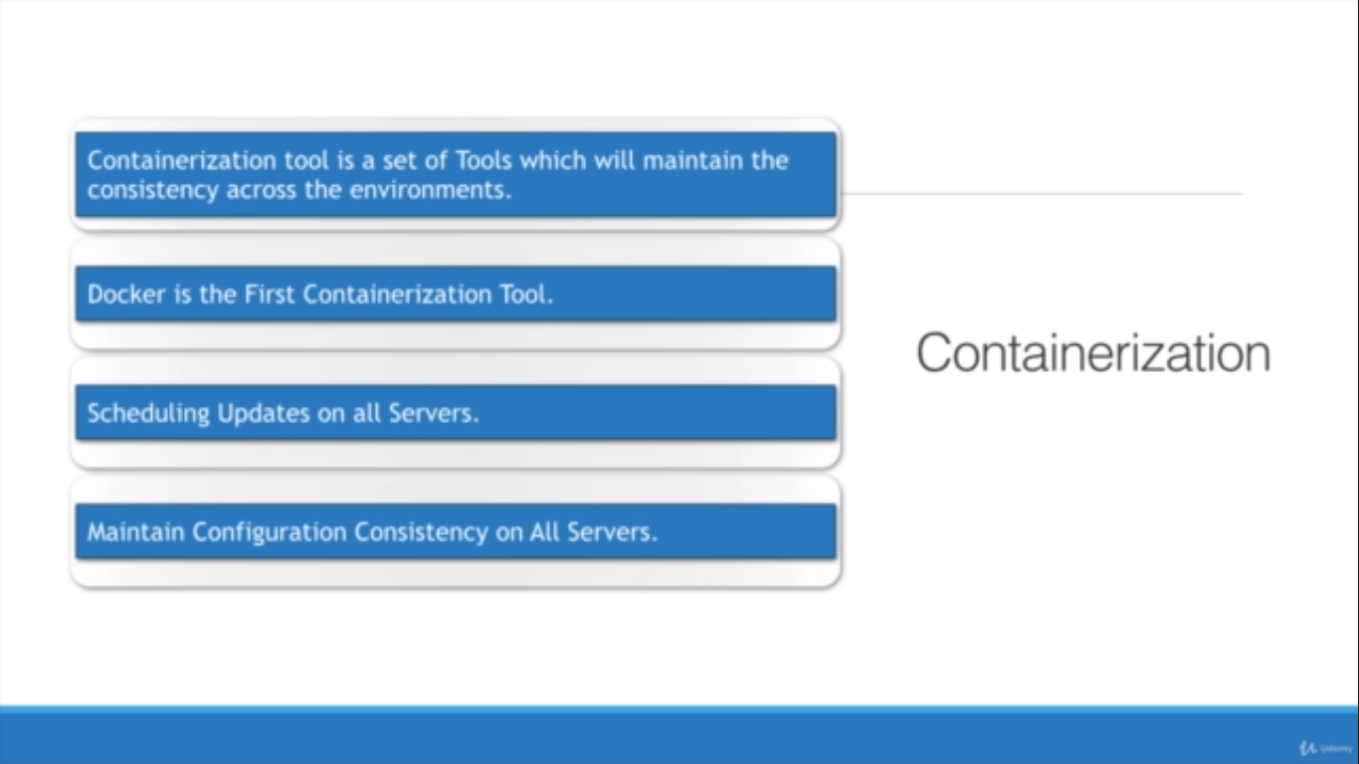
What is DevOps?

Slide 17
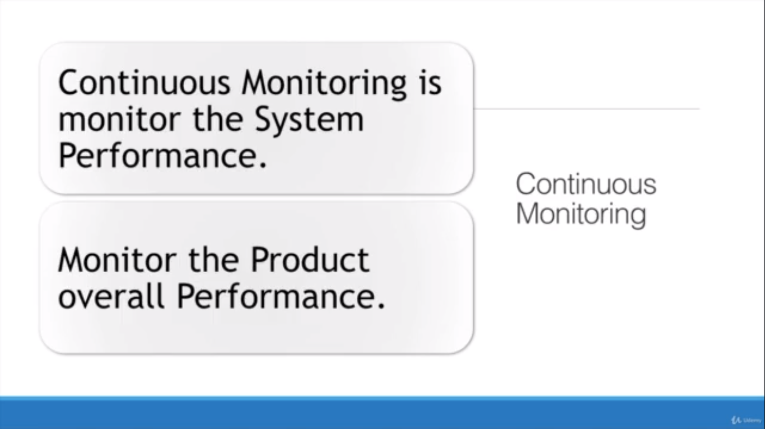
What is DevOps?

Slide 18
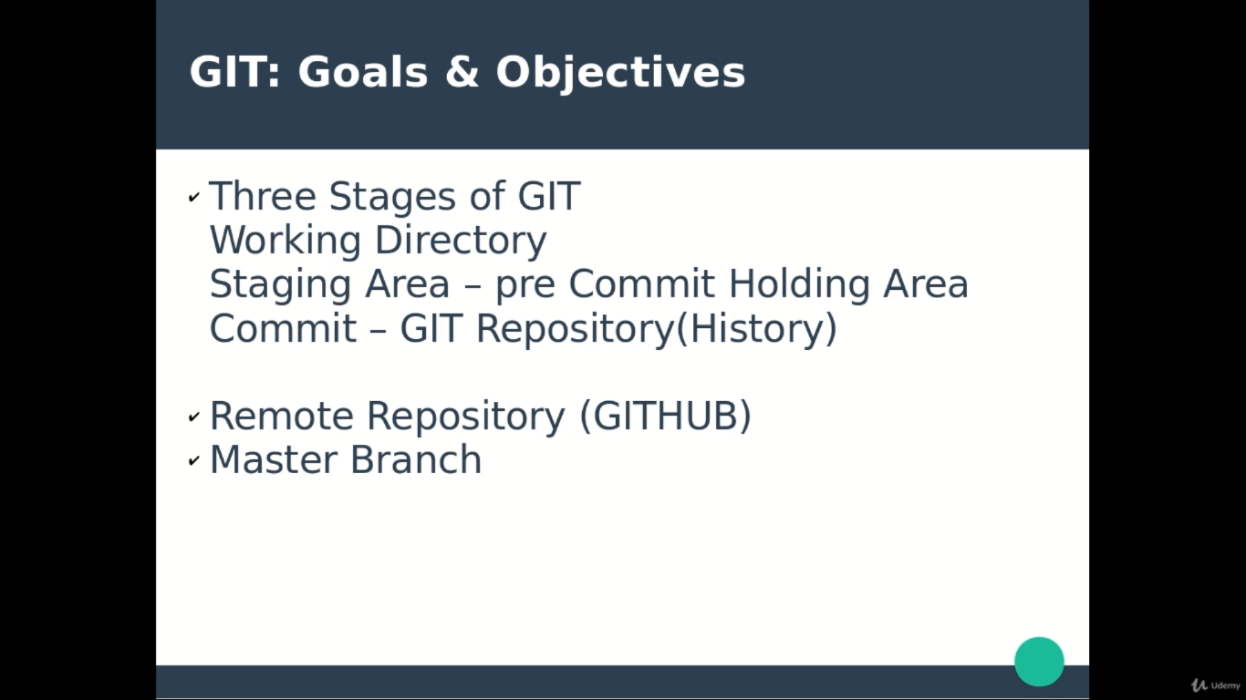
What is DevOps?

Slide 19
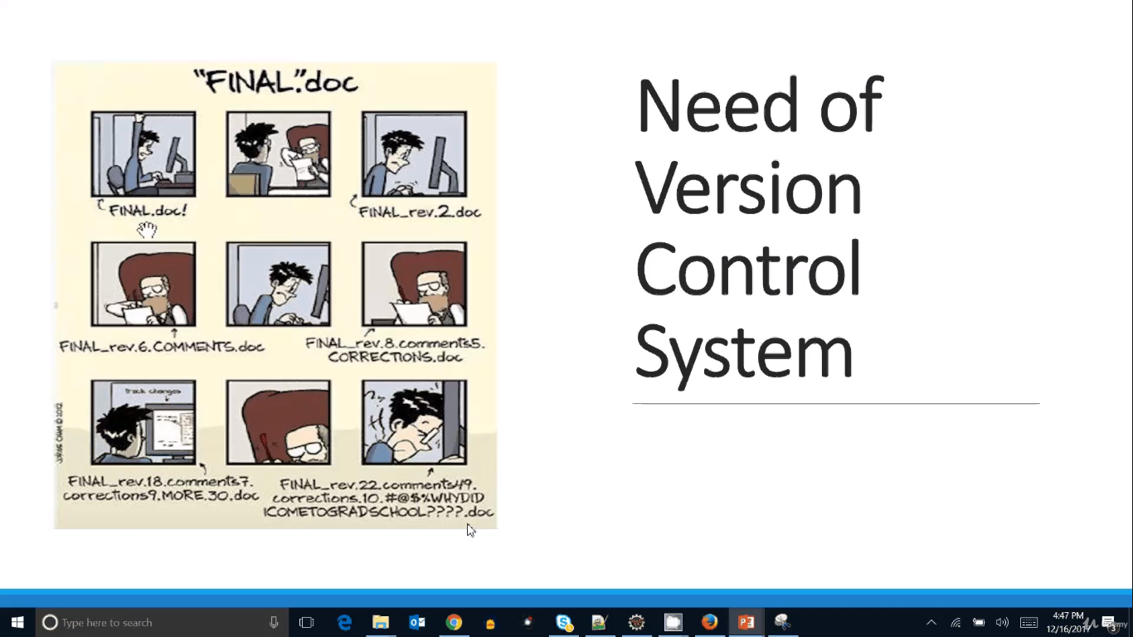
What is DevOps?

Slide 20
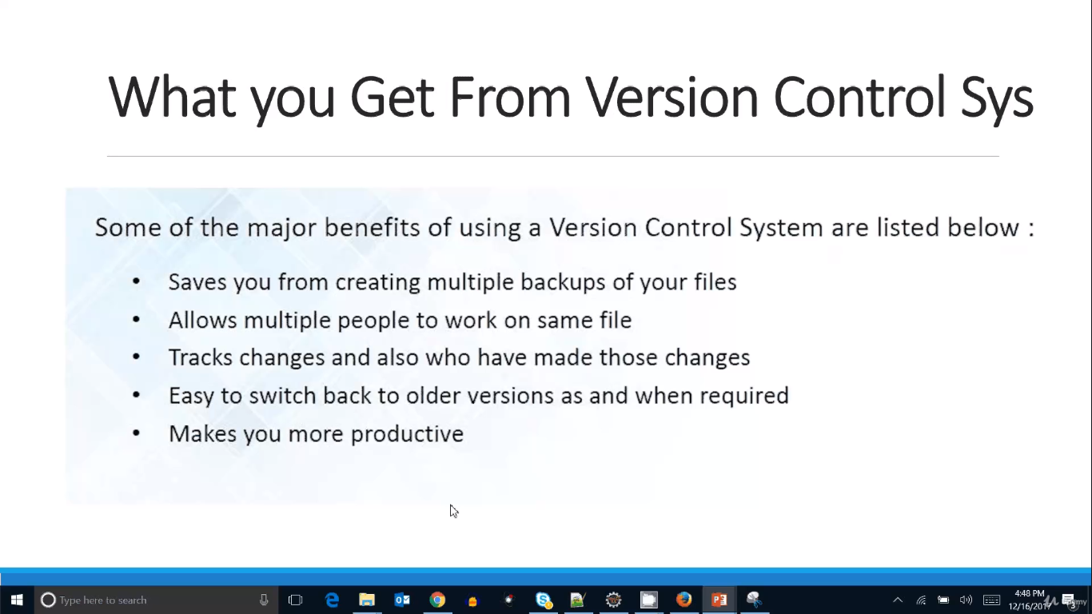
What is DevOps?

Slide 21
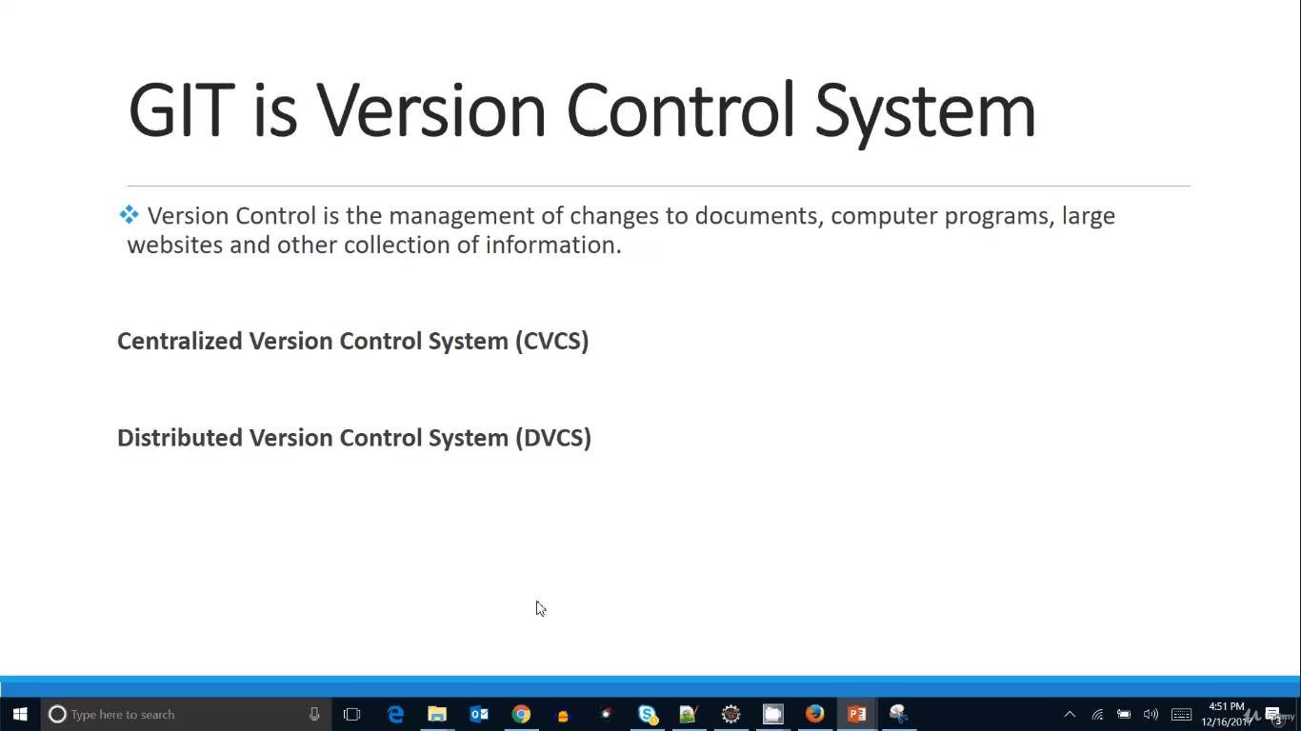
What is DevOps?

Slide 22
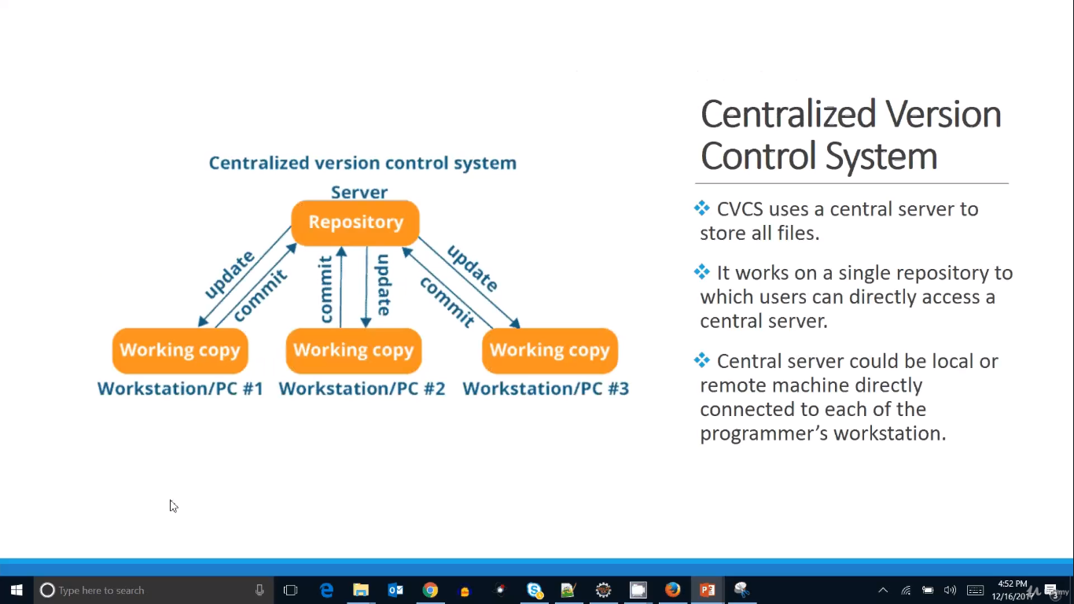
What is DevOps?

Slide 23
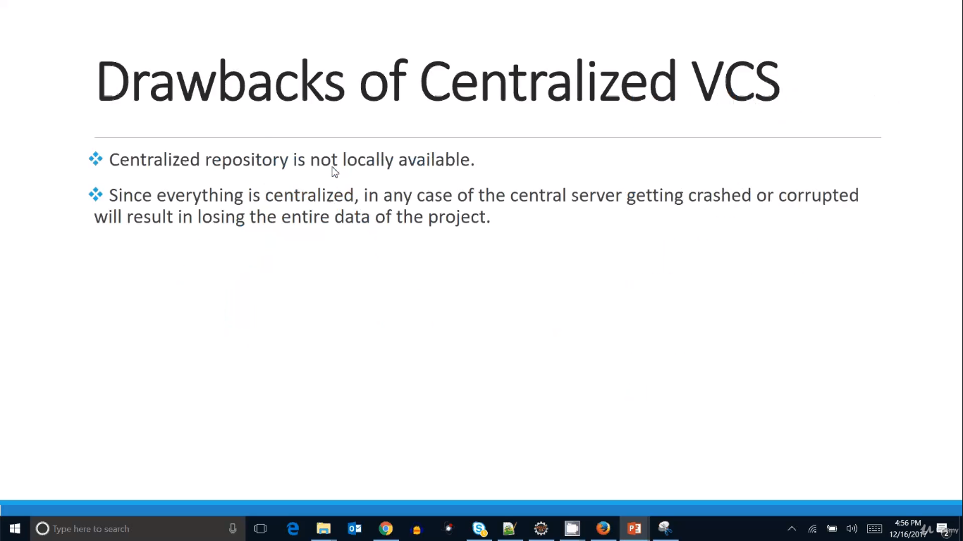
What is DevOps?

Slide 24
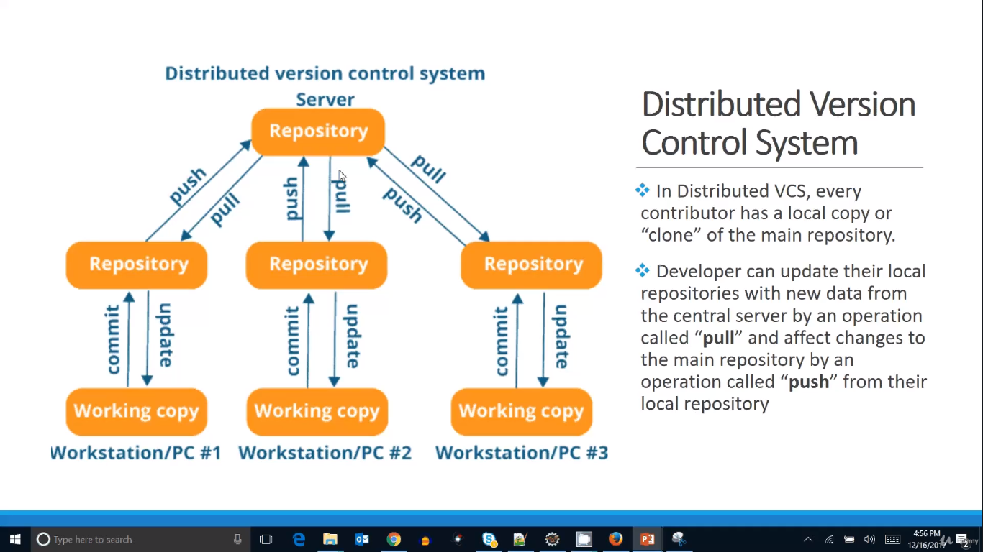
What is DevOps?

Slide 25
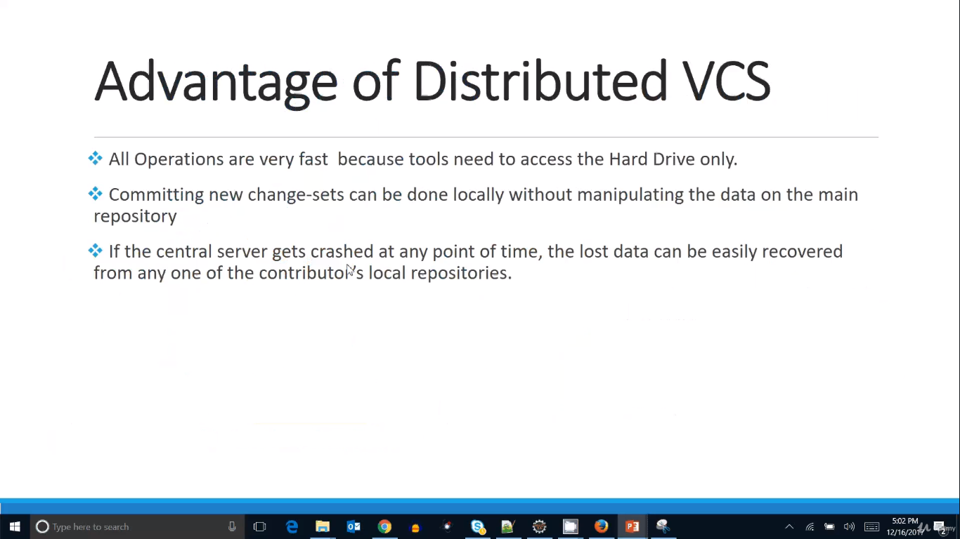
What is DevOps?

Slide 26
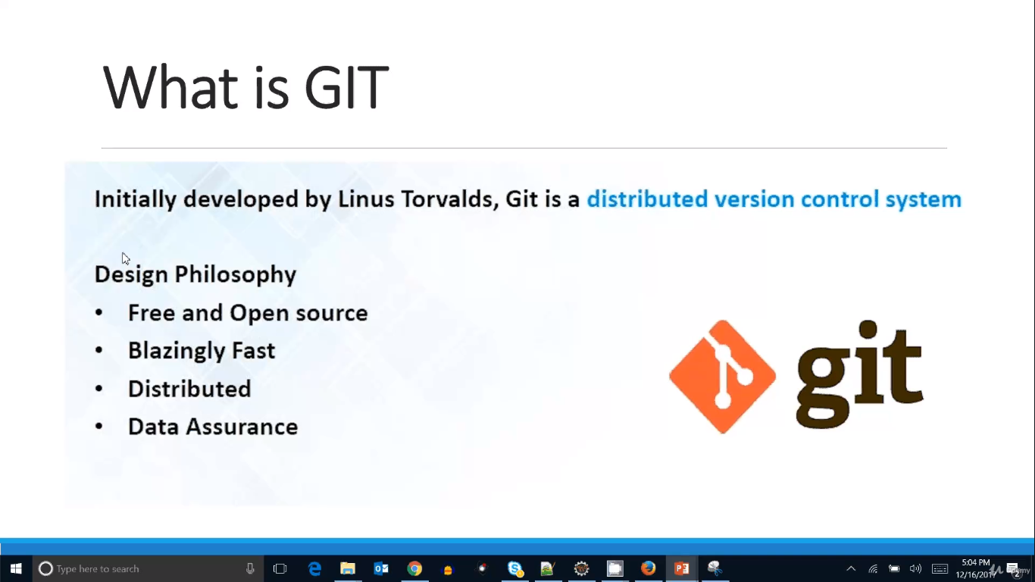
What is DevOps?

Slide 27
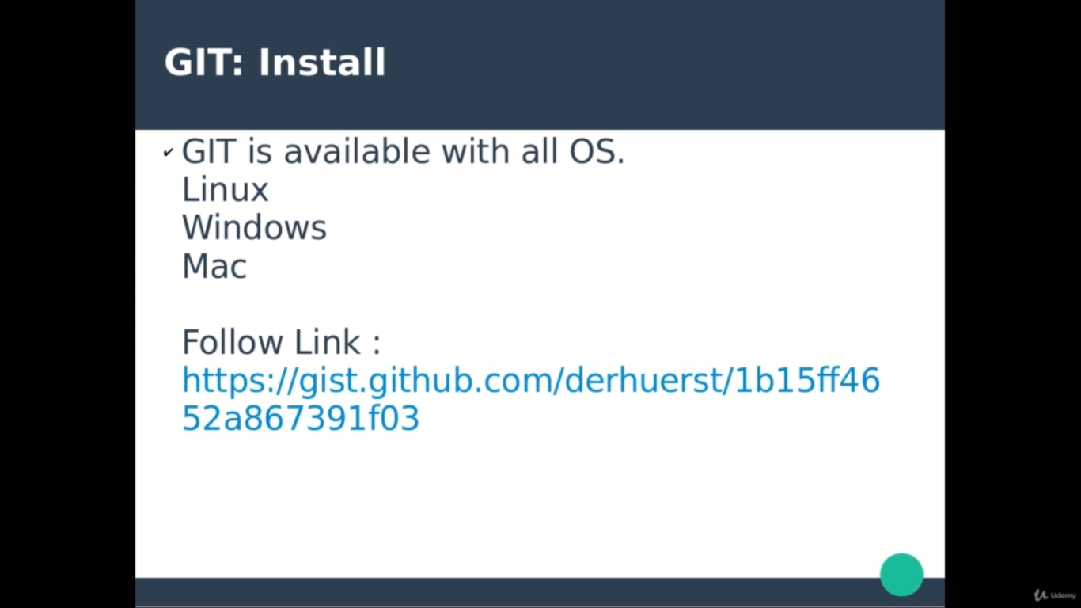
What is DevOps?

Slide 28
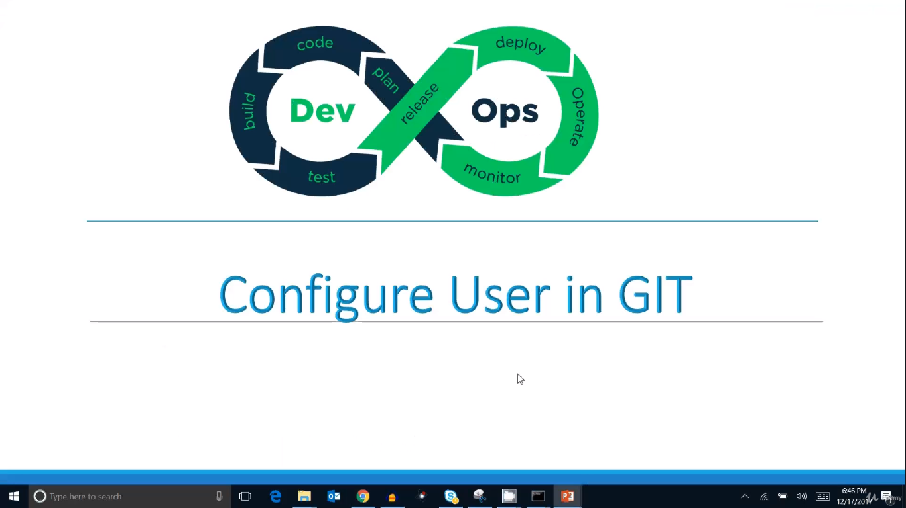
What is DevOps?

Slide 29
Once you configure the user and other attribute values in the configuration file then those values will be reflect and useful while performing commits,pull,push,update operations which can be easily find out the user who did those changes.
Every command in the GIT starts with ‘git’. For Example., $git config --list
To create the user, email and its command is
$git config --global user.name "Vijay Kumar, Tadepu"
$git config --global user.email "vijay2533@gmail.com"
Command to see whether the attributes are updated or not
$ git config --list
diff.astextplain.textconv=astextplain
filter.lfs.clean=git-lfs clean -- %f
filter.lfs.smudge=git-lfs smudge -- %f
filter.lfs.process=git-lfs filter-process
filter.lfs.required=true
http.sslbackend=openssl
http.sslcainfo=C:/Program Files/Git/mingw64/ssl/certs/ca-bundle.crt
core.autocrlf=true
core.fscache=true
core.symlinks=false
pull.rebase=false
credential.helper=manager
user.name=Vijay Kumar, Tadepu
user.email=vijay2533@gmail.com
Command to see the manual pages of commands. For Example., $git help commit which opens html pages

Slide 30
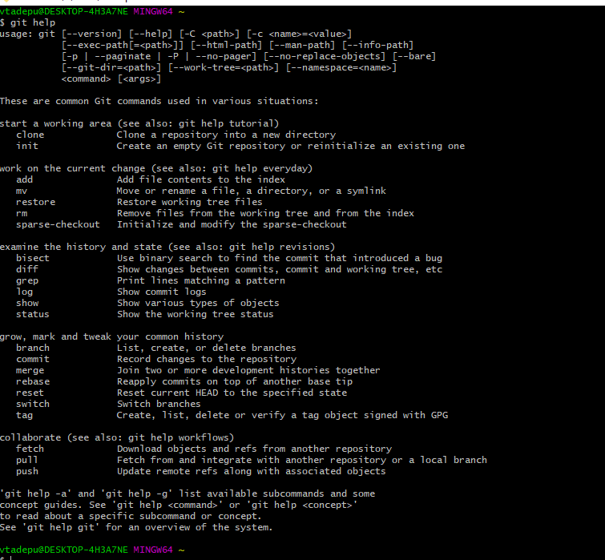

Slide 31
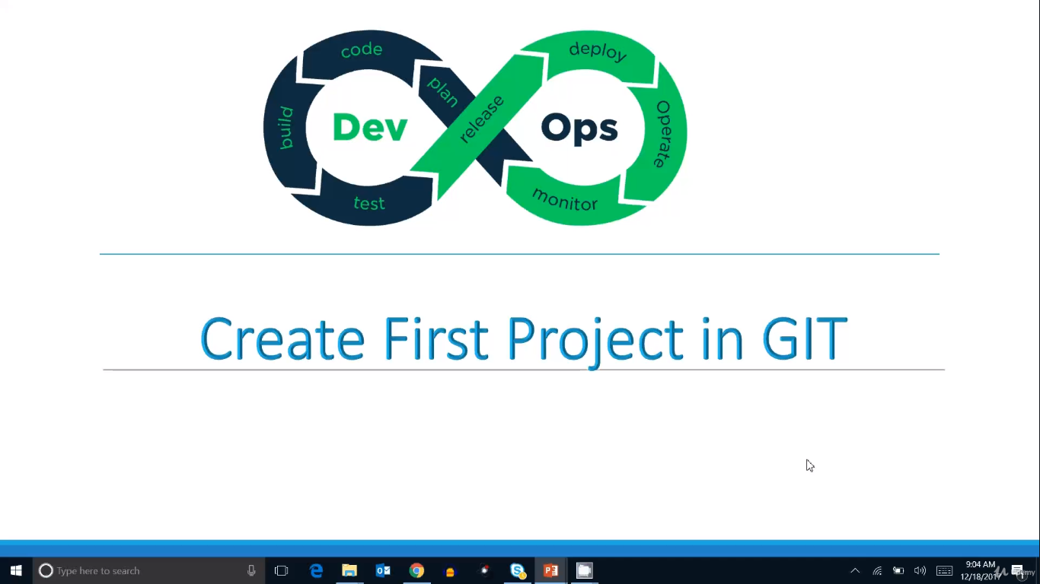
What is DevOps?

Slide 32
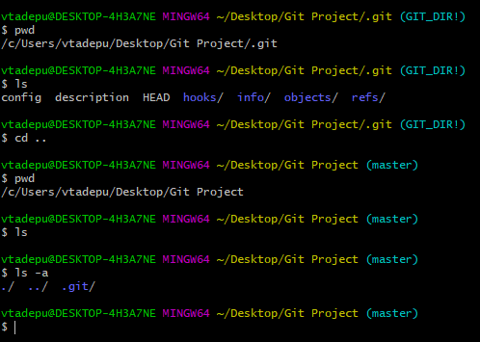
Creating a folder in the system is nothing but the working directory for the Git project
We have to init the git in the folder. Once execute the $git init then working directory will consists list of files related to git
Hidden folder called .git will be create in the working directory which has all the files related to git
Now working directory will be git project
Commands in the git will be same like linux which means all the linux commands will be applicable in git. For Example., Commands like pwd,cd, cd.. Etc.,

Slide 33
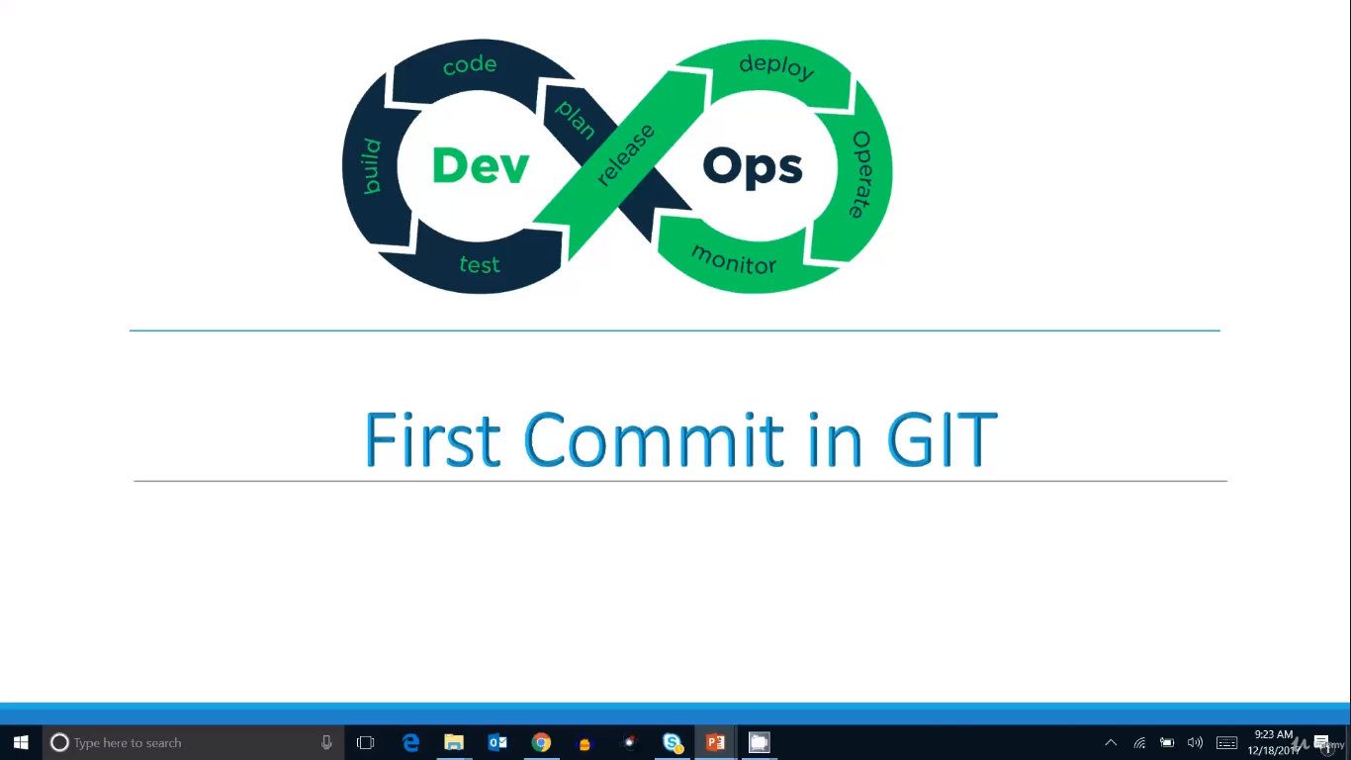
What is DevOps?

Slide 34
First check the status of the git using the command $ git status
Add the file or files into the git working directory. For Example., sample.txt with content
Execute the $ git status and will see a message like untracked file
Add the file into git for committing to repository using the command $ git add sample.txt or $ git add . (basically dot (.) is nothing but all file in the directory)
Commit the file using the command $ git commit -m “My First Commit” (-m means message)
Modify the file (sample.txt) content and check the git status then you will see message like modified: sample.txt then later execute git add and commit commands like above 4,5 steps

Slide 35
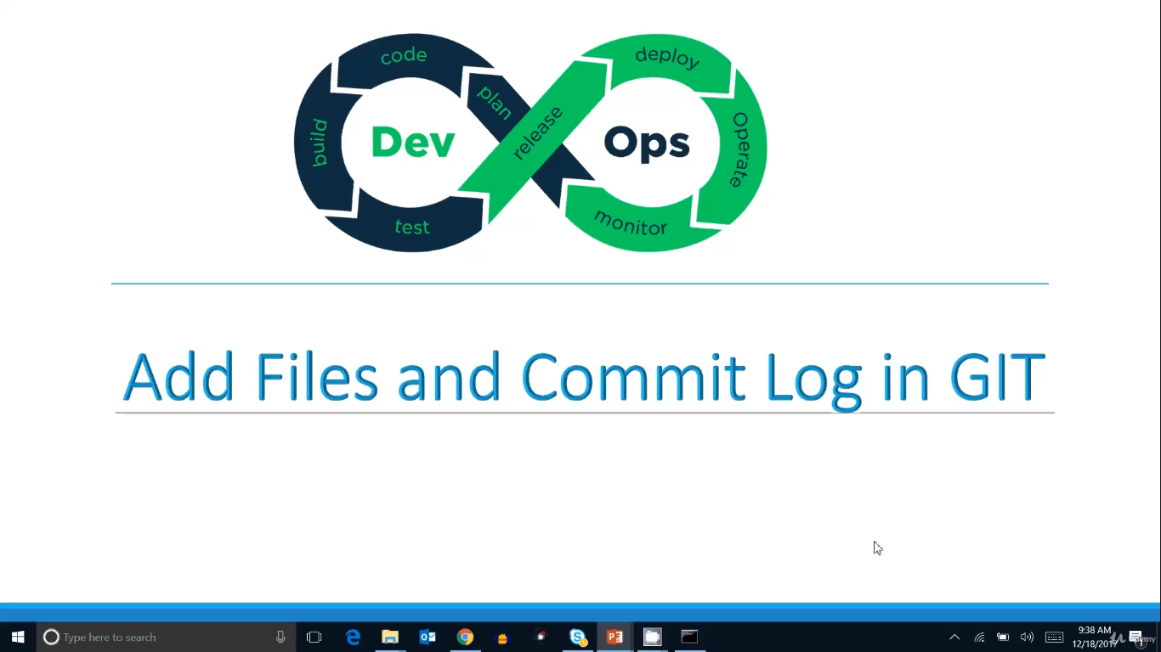
What is DevOps?

Slide 36
Add the multiple files into the git working directory like sample1.txt, sample2.txt etc.,
Execute the add and commit commands. Refer previous slide for commands
Check the git log using the command $git log which gives the history of the commits
Check the log for the particular user then use the command
$git log --author=”Vijay, Kumar”

Slide 37
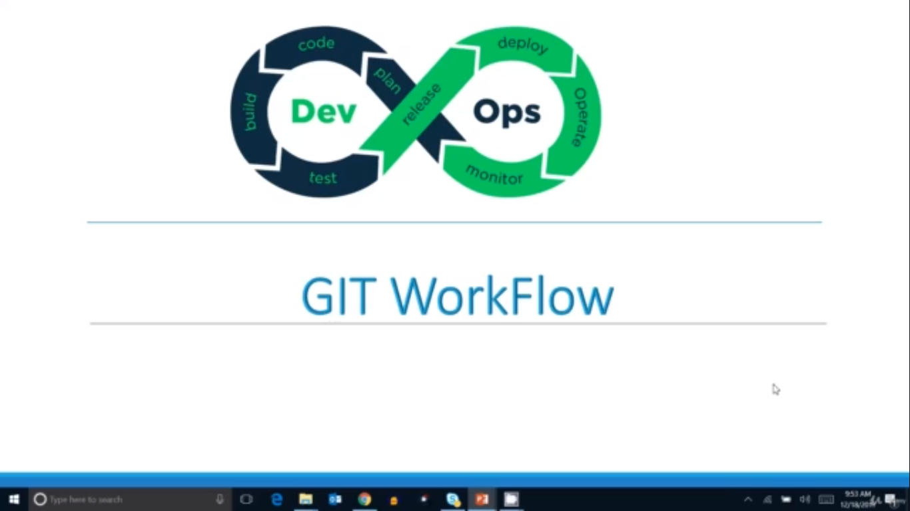
What is DevOps?

Slide 38
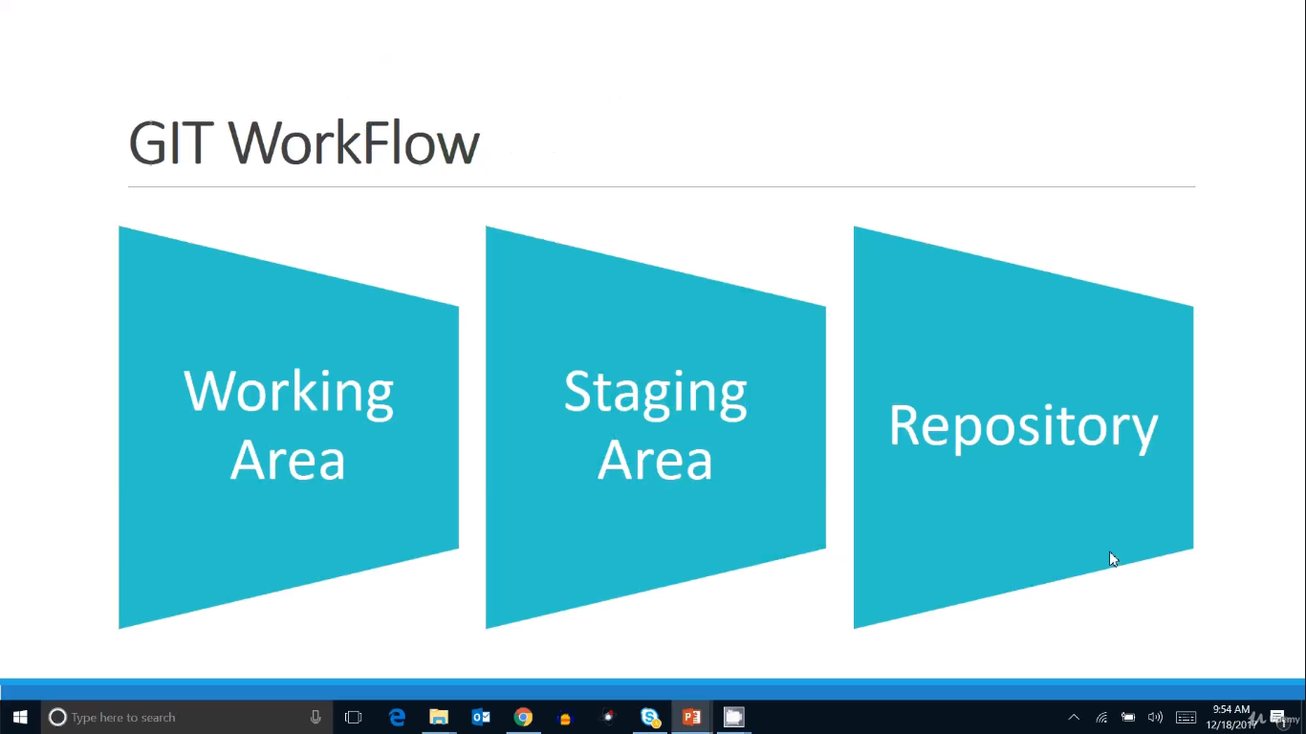
What is DevOps?

Slide 39
Use the git commands like status, add, commit to explain the above slide
Working directory means where files and folders are exists
Now, add or delete or update operations in the working directory
Execute the command $git status which tells the clear message like files are unstaged
Now, execute the command $git add <filename> then it is ready to commit
Atlast, execute the command $git commit -m “Commit message” then file will move to git repository

Slide 40
GIT: Text Editor for GIT
Windows
Notepad++
Bash Alias
MacOS
TextMate2
Linux
Sublime Text

Slide 41
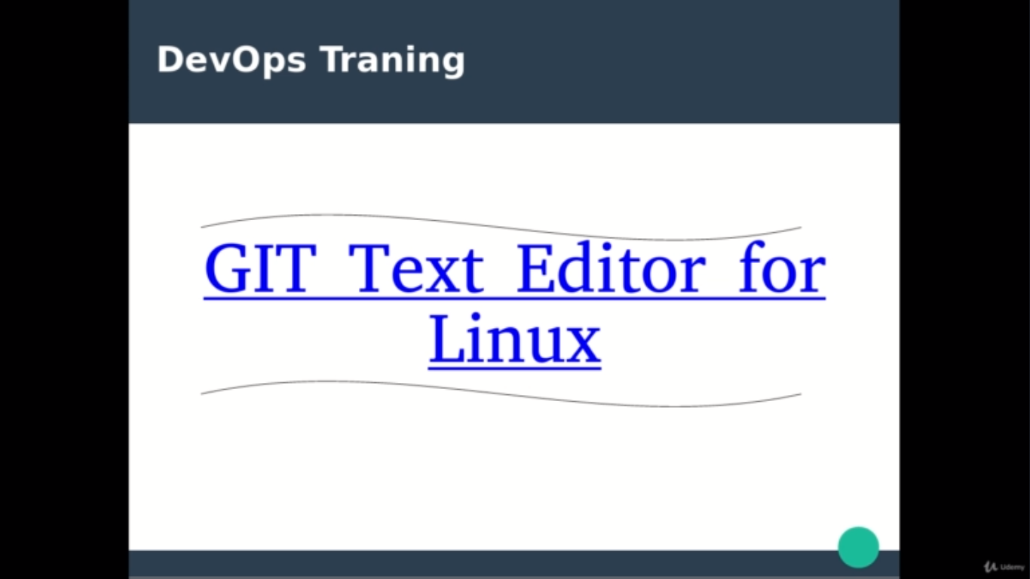
What is DevOps?

Slide 42
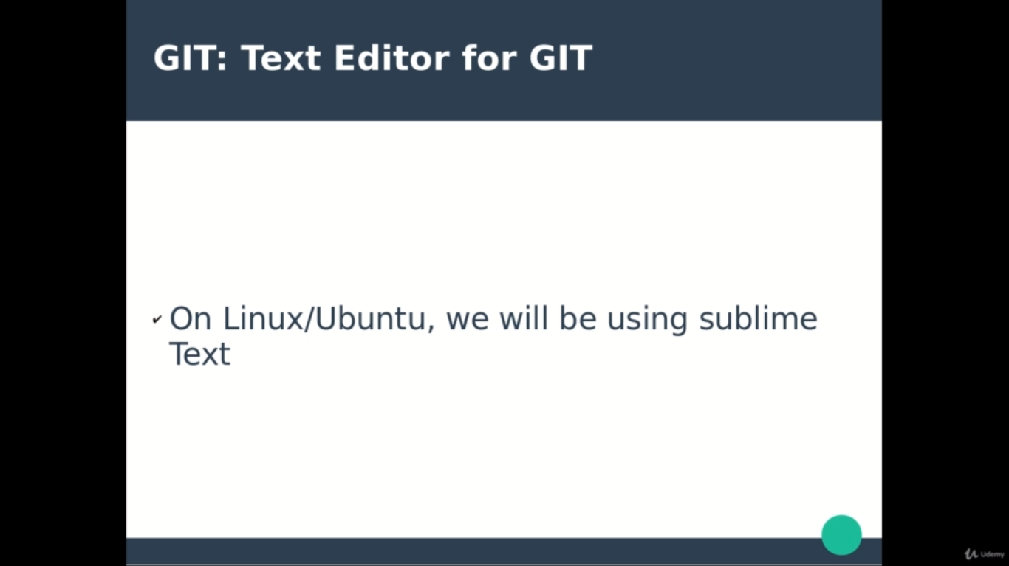
What is DevOps?

Slide 43
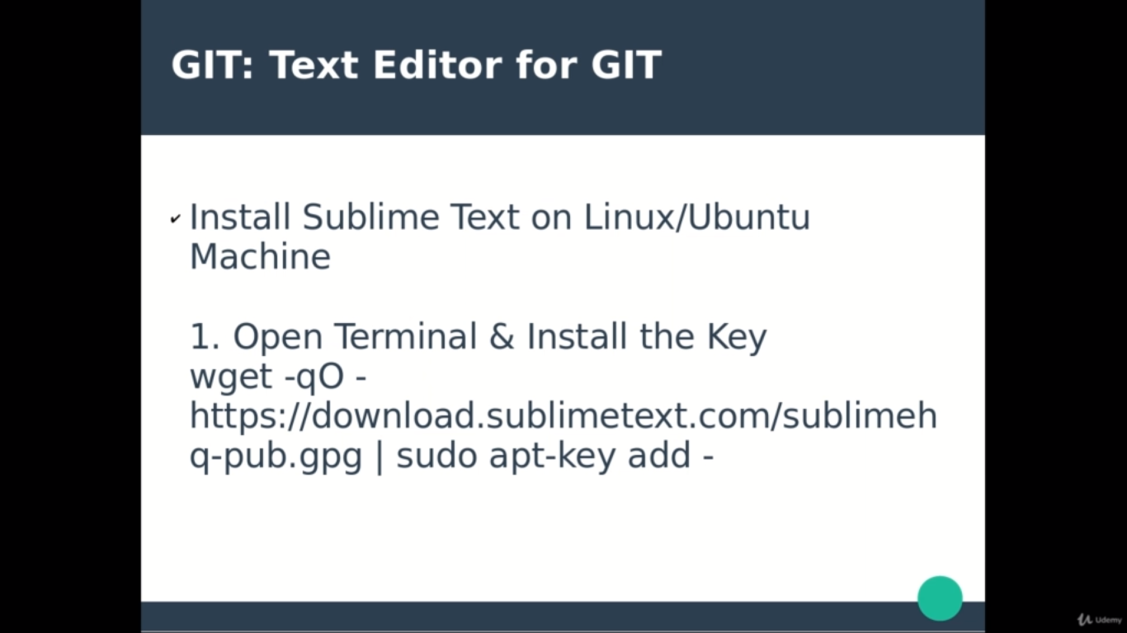
What is DevOps?

Slide 44
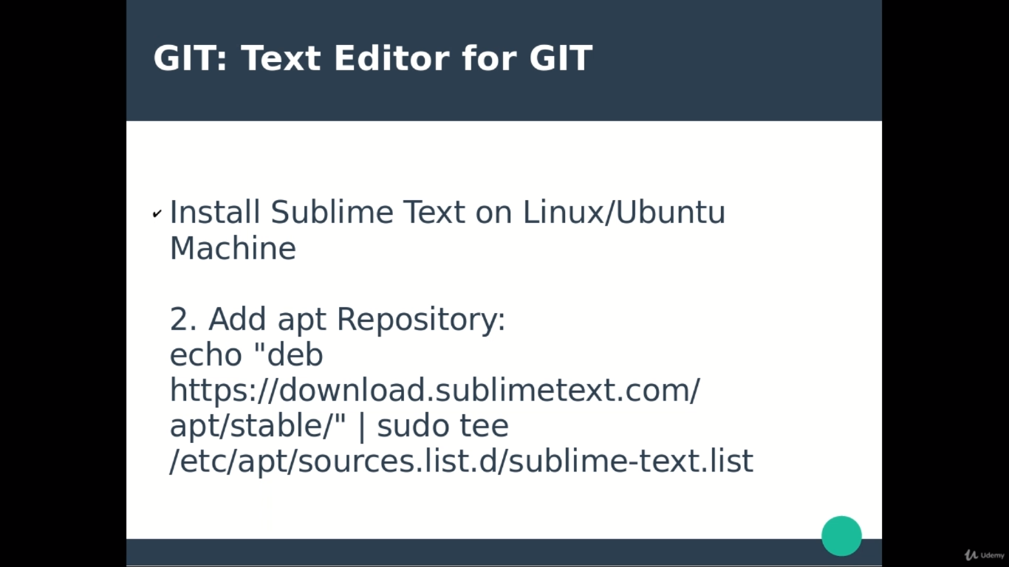
What is DevOps?

Slide 45
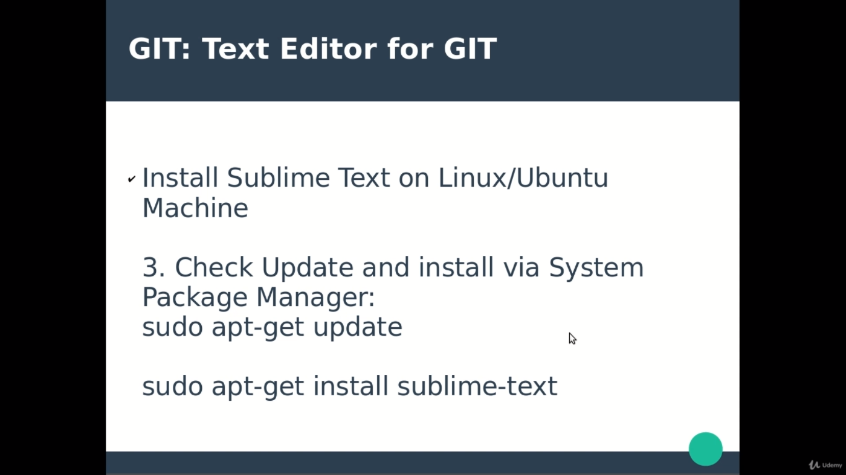
What is DevOps?

Slide 46
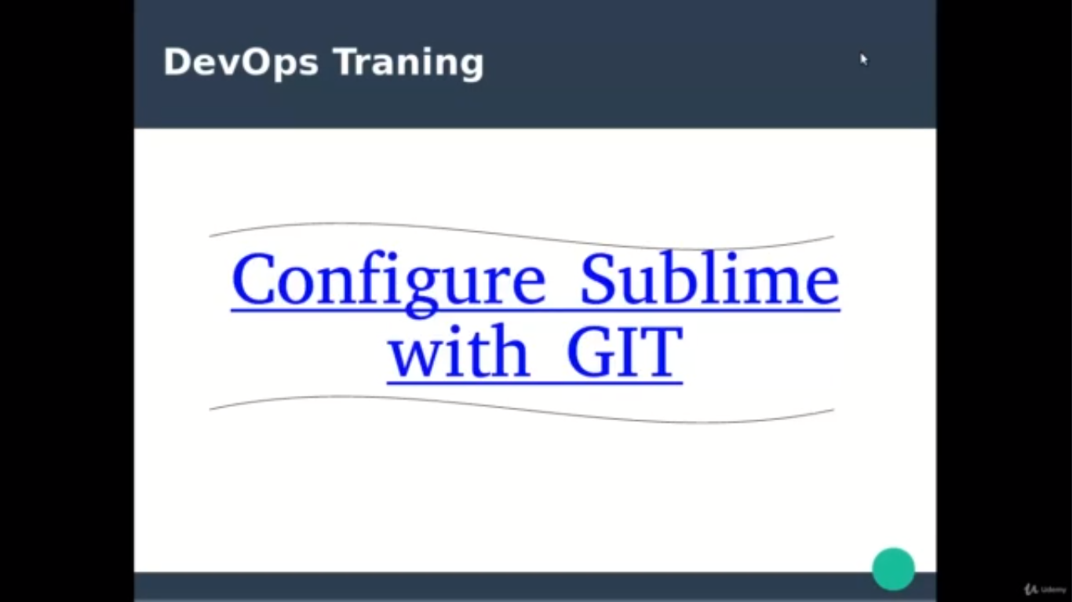
What is DevOps?

Slide 47
Basically, by default GIT has its own text editor i.e., NANO editor which is not comfortable to use and also not the user friendly tool. So that’s why we will configure the text editor for GIT like notepad++ for windows and SubLime editor for Linux which are user friendly to use.

Slide 48
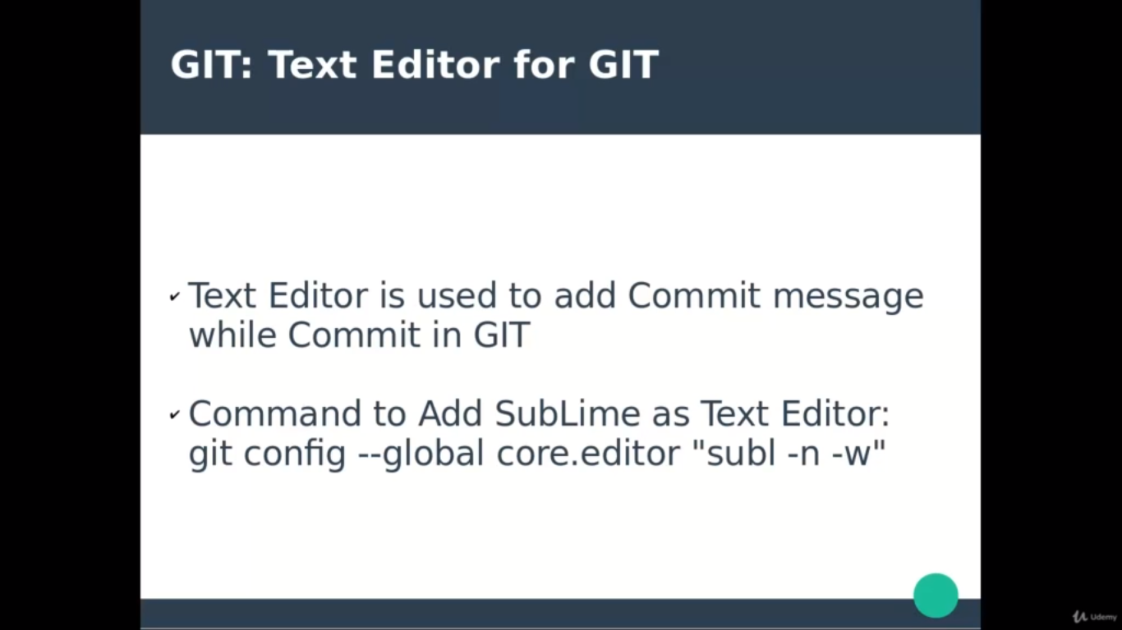
What is DevOps?

Slide 49
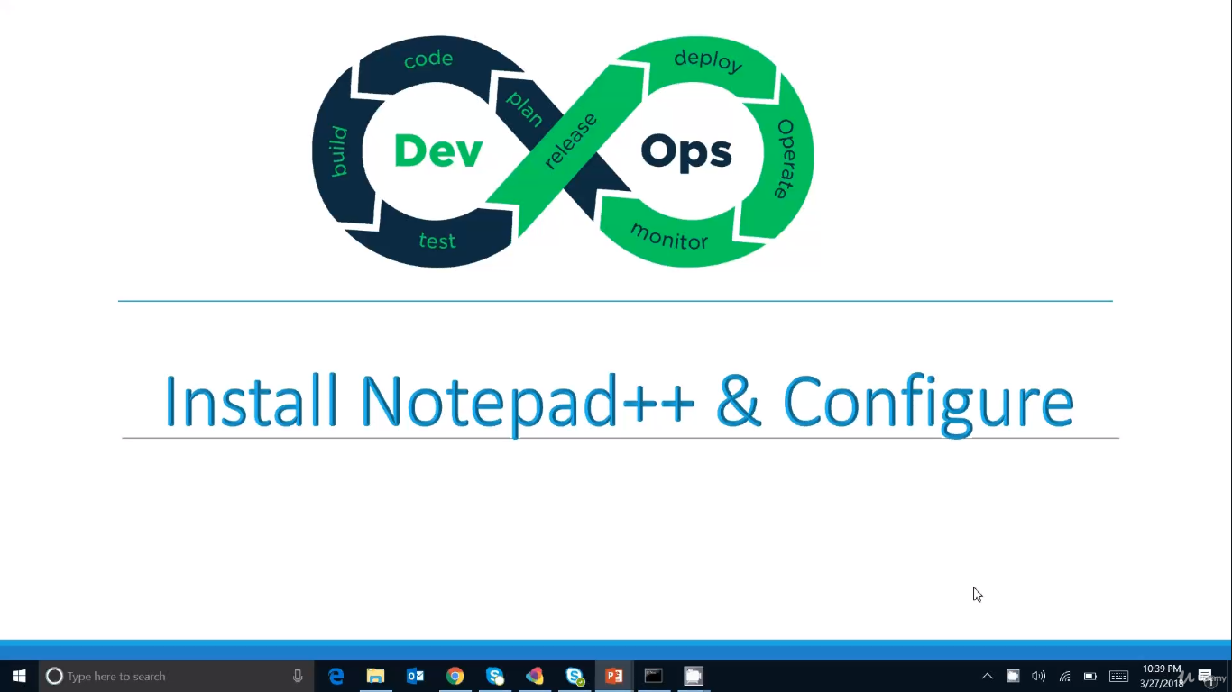
What is DevOps?

Slide 50
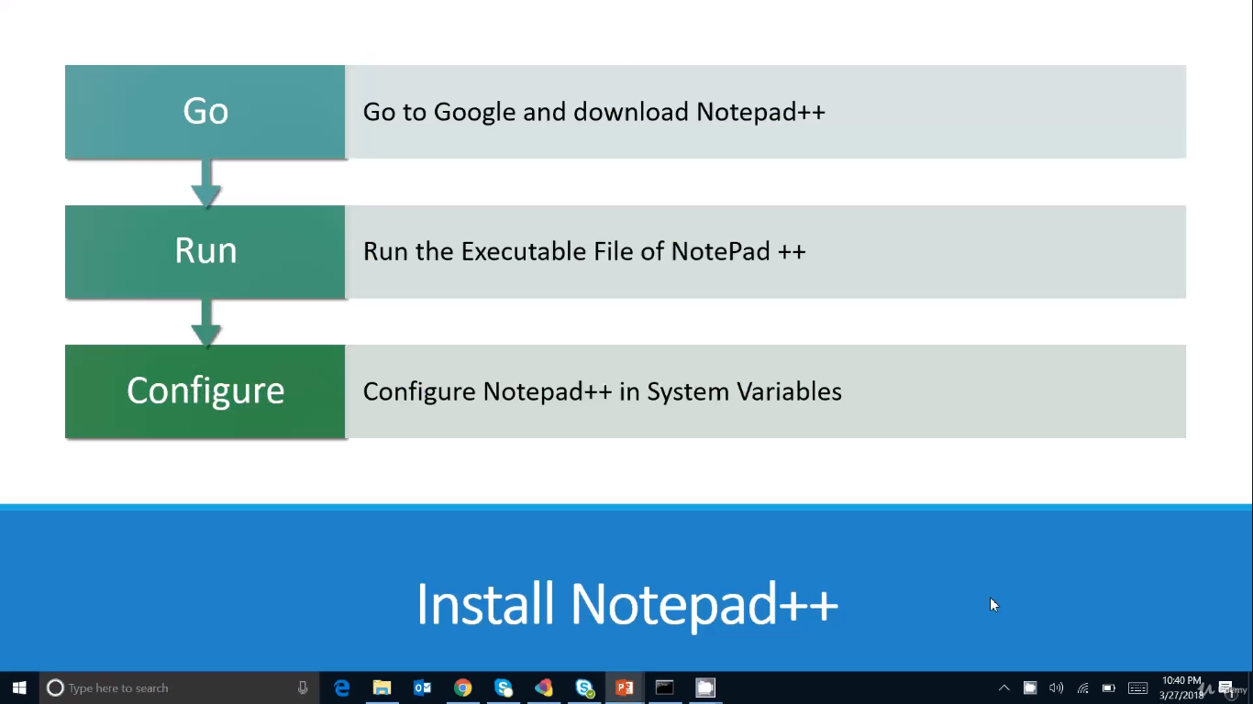
What is DevOps?

Slide 51
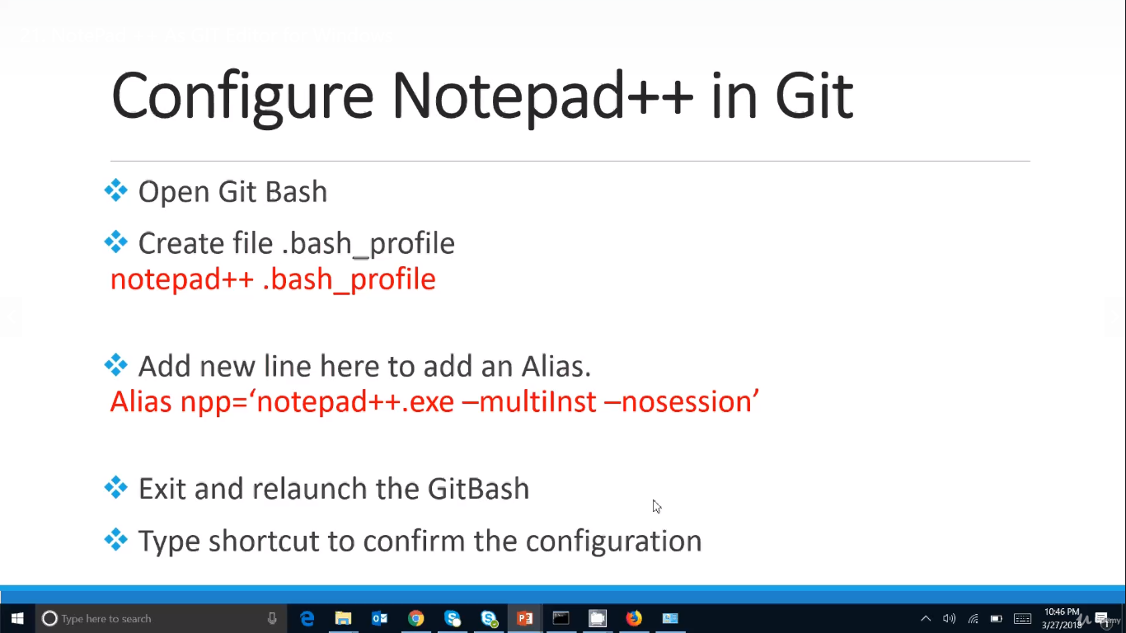
What is DevOps?

Slide 52
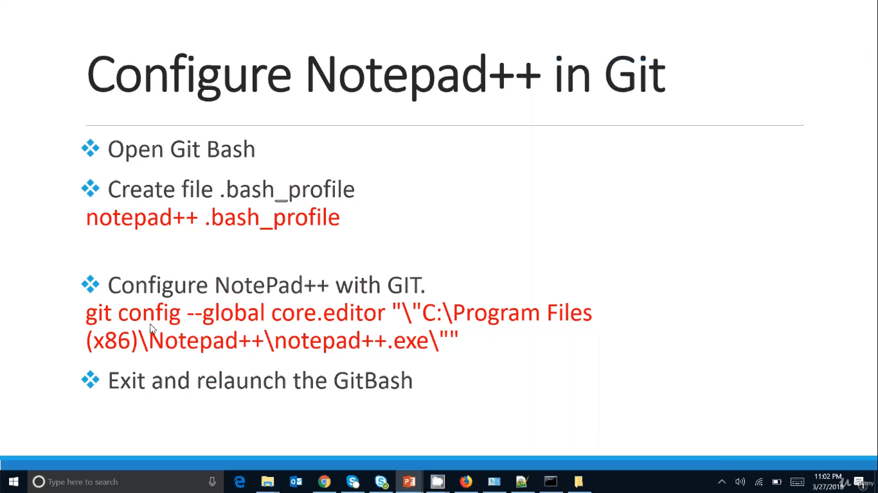
What is DevOps?

Slide 53
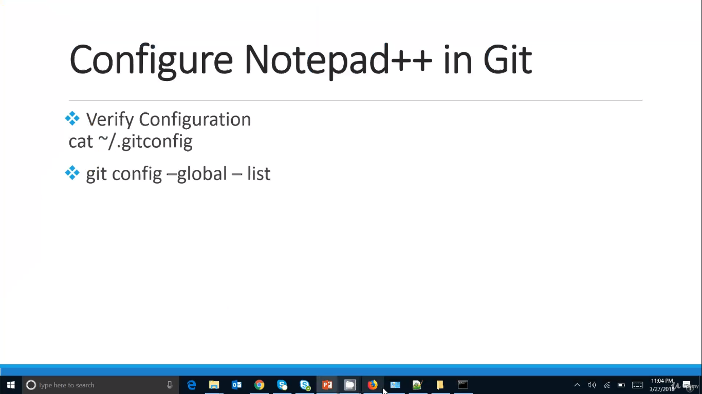
What is DevOps?

Slide 54
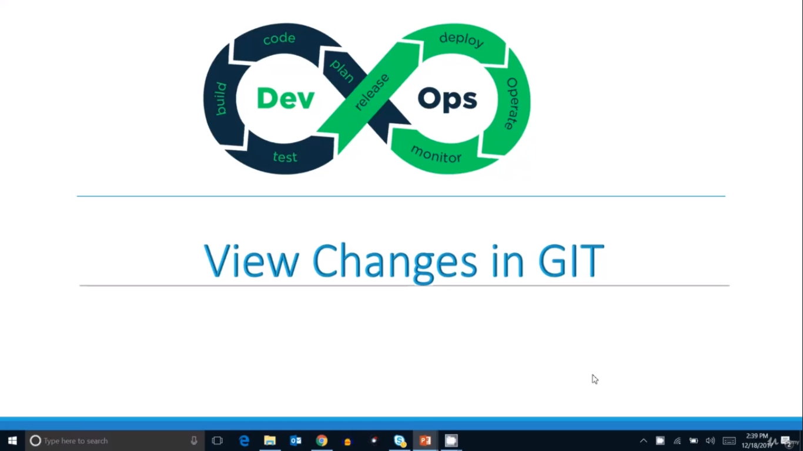
What is DevOps?

Slide 55
Using the command $git status can see the current changes between the stages. If we execute the $git add . and $git commit -m “commit message” then below commands will not show any result which means all the stages are synced.
Using the $git diff command, we can see the difference between working area and staging area and which will not show difference between staging area and local git repository
Using the $git diff --staged command, we can see the difference between staging area and local git repository
If above two command not show any result then working area is synced with staging area and staging area is synced with local git repository

Slide 56

What is DevOps?

Slide 57
Using the $git rm <filename> command which removes the file from git repository
Once the file exists in the local git repository then above command will be applicable to remove the file from repo
Once the file is created in the working directory then we need to add and commit the file then only file will be visible in the repo and can be removable

Slide 58
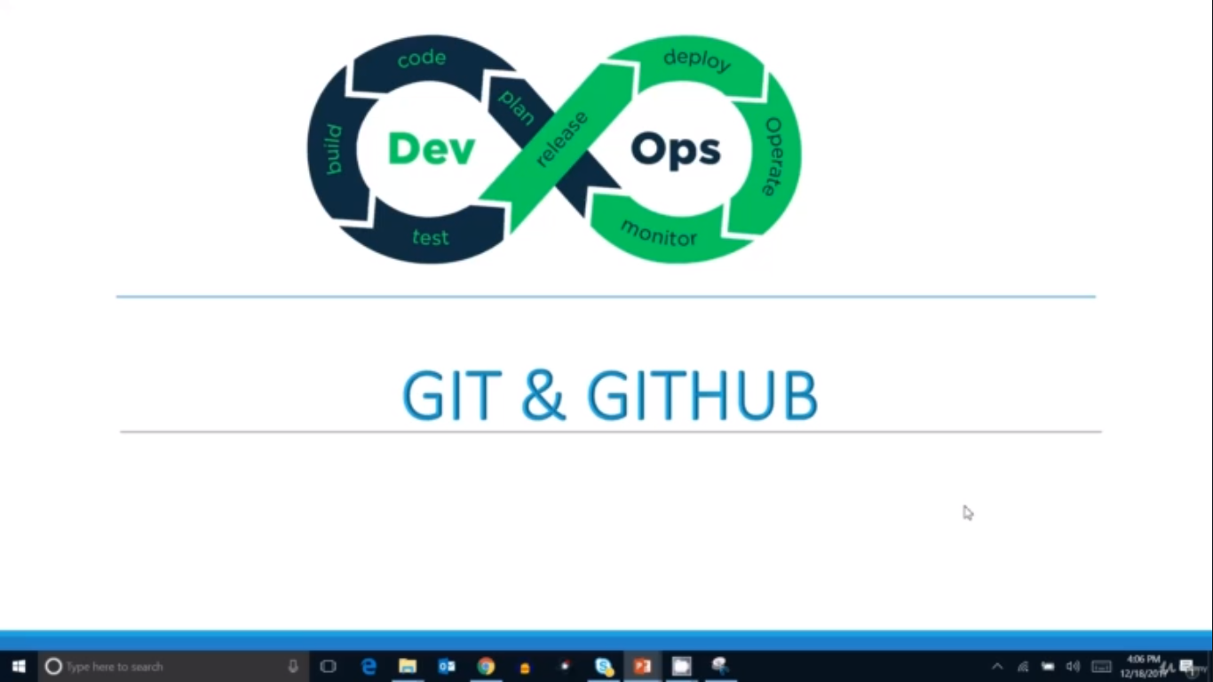
What is DevOps?

Slide 59
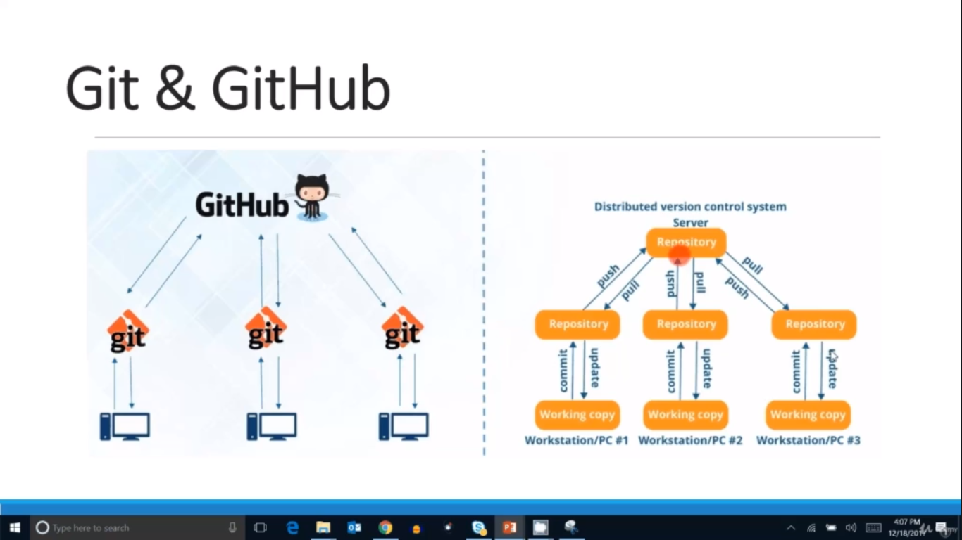
What is DevOps?

Slide 60
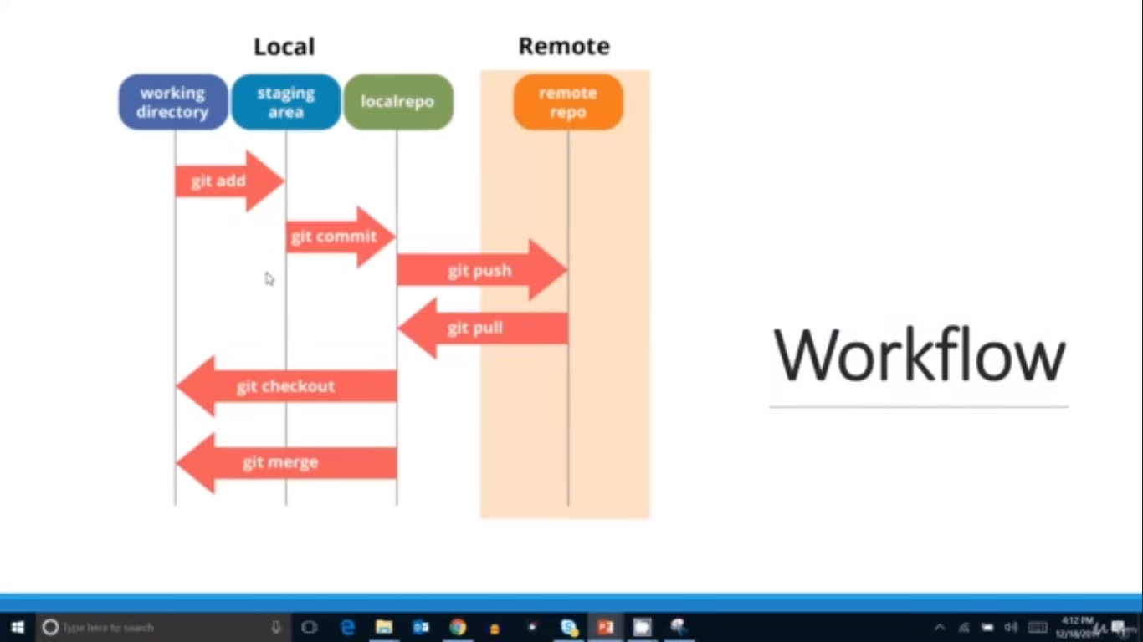
What is DevOps?

Slide 61

What is DevOps?

Slide 62
Firstly, signup to github using the url https://github.com/
Create a new repository say repo name as gitHub1
Create a folder in the local working system
Open the bash terminal and execute $git init to initialize
Create any files in the local working directory
Execute below commands for adding the local repository to centralized repository ie.,gitHub:
$git status
$git add . OR $git add <file name>
$git commit -m “First Commit Message”
$git remote add origin “https://github.com/Vijay2533/git-gitHub.git”
$git pull origin master - which fetches the code from centralized repo
$git push origin master - which pushes the code to centralized repo and it ask for the username and password of the gitHub

Slide 63

What is DevOps?

Slide 64

What is DevOps?

Slide 65
Command to create the branch i.e., $git branch develop
Command to shift to the other branch i.e., $git checkout develop
Creating a branch is nothing but creating a pointer to that master branch. For example, A branch has many files. So file is present in master branch, once we create branch then that file has pointer to other branch as well. It means a single git storage with multiple pointers.
Creating a files commit in develop branch will not be available until and unless merge that code to master branch. As per the standard, merging to master branch will be done after the proper testing done on develop branch.

Slide 66

What is DevOps?

Slide 67

What is DevOps?

Slide 68
Command to merge the code to master Firstly, go to the target location (here target location is master branch. Use $git checkout master to shift) and then execute $git merge develop. After that push the changes to the original repository ($git push origin master)
After creation of branch and checkout to that branch then need to push changes to the central repository. $git push origin develop

Slide 69

What is DevOps?

Slide 70
$git reset HEAD SampleFile.txt is the command to revert changes of that particular file.
$git reset HEAD~ is the command to revert the last commit
Using $git log command, can check the last commit changes log

Slide 71

What is DevOps?

Slide 72

What is DevOps?

Slide 73

What is DevOps?

Slide 74

What is DevOps?

Slide 75

What is DevOps?

Slide 76
Copy the clone URL of existing project from GitHub Account. URL looks like https://github.com/Vijay2533/starter-web.git
Open the folder or directory from your local computer and then open the GIT bash from the same location
Type the command like $git clone https://github.com/Vijay2533/starter-web.git
Check the status of the project using the command $git status

Slide 77

What is DevOps?

Slide 78

What is DevOps?

Slide 79
$git checkout -- <fileName> is the command to revert the changes from working directory
$git reset HEAD <fileName> is the command to revert the changes from staging area
$git reset HEAD~ is the command to revert the changes from local git

Slide 80
Delete, Rename & Move File in GIT
$git rm <fileName> is the command to delete the file from the directory
We can restore the deleted file from git using the command as $git reset HEAD <fileName> which will unstaged the deleted file. Then after, in the staging area execute the command $git checkout -- <fileName> which will restore the file in the file system (working area)
$git mv <filename1> <filename2> is the command to rename the filename
$git mv <filename1> <Dir Name> is the command to move the file to the specified directory.

Slide 81

What is DevOps?

Slide 82

What is DevOps?

Slide 83
$git log --since=”2 days ago” which will display the commit of 2 days ago
$git help log which will display the complete options related log command
$git show <commit-ID> which will display complete information of the particular commit ID
$git log --grep=”text” which will display the commit using the search text
$git log --all --oneline --graph --decorate

Slide 84

What is DevOps?

Slide 85

What is DevOps?

Slide 86
$git config --global alias.history "log --all --oneline --graph --decorate" is the command which will create short command for the long command. So once enter the $git history which will display output of the command $git log --all --oneline --graph --decorate
Above config change can be see in the console using the command $git config --list
In order to edit the alias config then execute the command as $vi ~/.gitconfig which will open the information in vi mode then edit the content and save it.

Slide 87

What is DevOps?

Slide 88

What is DevOps?

Slide 89

What is DevOps?

Slide 90

What is DevOps?

Slide 91

What is DevOps?

Slide 92

What is DevOps?

Slide 93

What is DevOps?

Slide 94
A) $git status, B) $git add . , C) $git commit -m “Message” are commands to comparison the setup
A) $git diff, B) $git diff <filename> are the commands to check the difference between working directory and staging area
A) $git diff HEAD, B) $git diff HEAD <fileName> are the commands to check the difference with the last commit
A) $git diff --staged HEAD, B) $git diff --staged HEAD <fileName> are the commands to check the difference between staging area and repository
A) $git log --oneline, B) $git diff <Commit ID>, B) $git diff HEAD HEAD^ are the commands to check difference using the commit ID and Last and Last but one.
$git commit -am “message” is the command which is combination of $git add <filename> and $git commit -m “message”

Slide 95

What is DevOps?

Slide 96

What is DevOps?

Slide 97

What is DevOps?

Slide 98

What is DevOps?

Slide 99

What is DevOps?

Slide 100

DevOps and its tools

Slide 101
$git branch -a will gives the list of branches and $git branch <branch name> will create a branch.
$git checkout <branch name> will shift to the specified branch. E.g., $git checkout develop
Modify any file in the branch and then add it which will move from working directory to staging area. So if you shift to any branch also then when you execute $git status then will give same results as the file is moved to staging area, since the file is moved to staging and ready to commit to anyone of the branch. Once commit to any of the branch then that modified file will not be reflect to other branches.
In order to reflect the above commit then we need to use command as $git merge <source name>. Here we need to shift to target branch using checkout command and then execute the command $git merge <source>, source is nothing but where the committed that modified file of branch name. E.g., $git merge develop

Slide 102

DevOps and its tools

Slide 103
When we modify the same file in different branches and then try to execute the merge command which will gives you the conflict message since git can’t understand will content to be merge to that file. So in that case, manually change the file and then commit it to avoid the conflicts between the branches
$git merge <source - branch name> which will result the conflict message like below. It means modified file of different branch will be merge, which means we can see the entire content in the file but need to review the file and change it accordingly manually, since file has all the modified content.
$ git merge automation
Auto-merging humans.txt
CONFLICT (content): Merge conflict in humans.txt
Automatic merge failed; fix conflicts and then commit the result.
$git checkout -b <branch name> which create a new branch and shift to that
Branch. It means command is combination of $git branch and $git checkout
<branchname>

Slide 104

DevOps and its tools

Slide 105

DevOps and its tools

Slide 106

DevOps and its tools

Slide 107

DevOps and its tools

Slide 108

DevOps and its tools

Slide 109

DevOps and its tools

Slide 110

DevOps and its tools

Slide 111

DevOps and its tools

Slide 112

DevOps and its tools

Slide 113

DevOps and its tools

Slide 114

DevOps and its tools

Slide 115

DevOps and its tools

Slide 116

DevOps and its tools

Slide 117
When we modify the same file in different branches and then try to execute the merge command which will gives you the conflict message since git can’t understand will content to be merge to that file. So in that case, manually change the file and then commit it to avoid the conflicts between the branches
$git rebase <source - branch name> which will result the conflict message like below. It means modified file of different branch will be merge, which means we can see the entire content in the file but need to review the file and change it accordingly manually, since file has all the modified content.
Modify the file manually and then Add. Commit the file
After that, execute $git rebase --continue which will avoid the conflicts
$git push --rebase origin master is the command to push the changes to github
If we do changes in github directly then we need to execute $git fetch and then rest will be the same commands

Slide 118

DevOps and its tools

Slide 119

DevOps and its tools

Slide 120

DevOps and its tools

Slide 121

DevOps and its tools

Slide 122

DevOps and its tools

Slide 123

DevOps and its tools

Slide 124

DevOps and its tools

Slide 125

DevOps and its tools

Slide 126
Modify the couple of files
Execute $git stash and check the list of stash using $git stash list
Move all the stash files to another branch to avoid conflicts of those files. Since there is chance of modifying the files by multiple developers which result us conflicts of the current branch. So to avoid this, we have to move all the stash to another branch. $git stash branch <new branch name>
Pointer points to new branch now where we can see all the stash files
After that add and commit all the files if needed

Slide 127

DevOps and its tools

Slide 128

DevOps and its tools

Slide 129

DevOps and its tools

Slide 130

DevOps and its tools

Slide 131

DevOps and its tools

Slide 132
$git status
$git tag <tagname> e.g., $git tag release1.0
$git tag --list which will display all the tags
$git tag --delete <tagname> which will delete the tag
$git tag -a <tagname> e.g., $git tag -a release2.0 which will open the editor to add the message for the tag and then execute the $git show <tagname> which shows the clear content of the tag
$git diff <tagname1> <tagname2> which gives the diff of both the tags
$git tag -a <tagname> <commitID> e.g., $git tag -a release3.0 110f6ab which will add tag to the specific commit ID
$git tag -a <tagname> <commitID> -f <commitID> which will update tag to the other commitID
$git log --oneline --decorate --graph --all which gives the log of all the commit history

Slide 133
DevOps and its tools

Slide 134
DevOps and its tools

Slide 135
DevOps and its tools

Slide 136
DevOps and its tools

Slide 137
DevOps and its tools

Slide 138
DevOps and its tools

